Slide 1

AN INTRODUCTION TO EHCPS AND OUTCOMES IN BEXLEY
PARENTS’ WORKSHOP
Bexley Voice
February 2023
Lisa, Janine and Graham

Slide 2

Introduction to EHCPs and Outcomes
Parent’s Workshop
Objectives
At the end of today’s workshop you will:
Understand the EHCP Process in Bexley
Understand your part in the assessment process
Understand how Outcomes drive the process
Know how to develop a good outcome
Produce at least one key outcome for your child/young person (YP)
Are there any other outcomes you expect?
2

Slide 3
From the Foreword to the Code of Practice
‘Our vision for children with special educational needs and disabilities is the same as for all children and young people – that they achieve well in their early years, at school and in college, and lead happy and fulfilled lives.’
‘Importantly, the aspirations for children and young people will be raised through an increased focus on life outcomes, including employment and greater independence’.

Slide 4
Background
The previous adversarial system of statements was replaced in 2014
The new Education, Health and Care Plan process focuses on OUTCOMES
Outcome focused planning highlights what is important to and for the child/young person and their family to help achieve their aspirations
Clear outcomes enable everyone to work together creatively with limited resources available to give children and young people the support they need

Slide 5

A Well Written EHCP…
Meets the requirements of the Act, Regulations and the Code.
Describes positively what children and YP can do
Is clear, concise, understandable and accessible
Is co-produced – places children, young people and their families at the heart of the plan

Slide 6

Overview of Process – Bexley Timeline
https://www.bexleylocaloffer.uk/Services/category/270

Slide 7
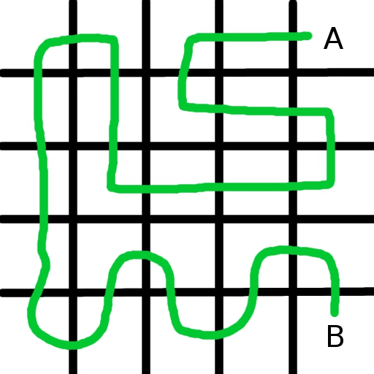
Linking Assessments and Plans
For each assessment, professionals should think about and be clear with families on:
The purpose of the assessment
The likely outcomes
How it builds on previous assessments
How professionals will work with families and agencies to share information appropriately

Slide 8
Child X DOB | Parent/Carer
Photograph | Family contact address
 | Language used at home? Interpretation required?
 | Siblings
 | Religion
 | EHCP Key Worker
 | EHCP Case Officer
 | Nursery/School/College attending
EDUCATION HEALTH AND CARE PLAN
WORKING DOCUMENT/DRAFT/FINAL MONTH YEAR [DELETE AS APPROPRIATE]
Confidentiality
Information shared and recorded in this plan will be circulated to those who have contributed advice and may also
be shared with those listed in the contacts and other professionals, where appropriate. A copy will be retained in the
child’s file in the respective teams involved with the child. We ask that upon receipt this plan not be copied or distributed.
As professionals, we respect confidentiality and must observe safeguarding and child protection procedures.
Reviewing the plan
The school/setting will review X’s progress regularly. Specific targets relating to the outcomes for X should be developed
as part of his individual educational programmes by those working with him/her. X’s Education, Health and Care plan
should be reviewed at least annually (or every 6 months if s/he is under 5 years of age) and reference should be made at
the review to the outcomes that s/he has been working towards. The review should consider how far the outcomes have
been met and give clear reasons for any unmet outcomes.
Contents – Sections of the Education, Health and Care Plan
A: Views, interests and Aspirations – parent and child/young person
B: Special educational needs
C: Health needs
D: Social care needs
E: Outcomes
F: Special educational provision
G: Any health provision reasonably required
H1: Social care provision under S2 of Chronically Sick and Disabled Persons Act 1970
H2: Any other social care provision
I: Name and type of setting
J: Personal budget
K: Advice and information gathered

Slide 9
Section A: Views, Interests and Aspirations
This should include:
Aspirations and goals for the future
Details about play, health, schooling, independence, friendships, FE, employment (where practical)
A summary of how to communicate with the child/YP
Child/ YP’s history
Must make clear whether child/YP is being quoted directly, or if the views of the parents or professionals are being represented

Slide 10
Section B: Special Educational Needs
Describe in detail all the child’s SEN identified during the assessment.
Should also include a description of the child’s/YP’s current functioning – what the child/YP can and cannot do
SEN may include those requiring health and social care provision where such provision is for the child or YP’s education or training
ACID TEST - Could a person new to the child/YP easily find out what are the priority areas of focus for the child’s/YP’s educational development?

Slide 11
Section C: Health Needs
EHCP must specify any health needs identified through the EHC needs assessment which relate to the child or YP’s SEN
Some health care needs, such as routine dental health needs, are unlikely to be related
CCG may also choose to specify other health care needs which are not related to the child or YP’s SEN (e.g. a long term condition which might need management in a special educational setting)
ACID TEST - Could a person new to the child/YP easily find out what are the priority areas of focus for the child’s/YP’s health intervention?

Slide 12
Section D: Social Care Needs
EHCP must specify any social care needs identified through the EHC needs assessment which relate to the child or YP’s SEN or which require provision for a child or YP under 18 under S2 of the Chronically Sick and Disabled Persons Act 1970.
LA may also choose to specify other social care needs which are not linked to the child or YP’s SEN
Could include reference to any child/YP in need or child protection plan – such inclusion must only be with the consent of the child/YP and their parents
ACID TEST - Could a person new to the child/YP easily find out what are the priority areas of focus for the child’s/YP’s social care intervention?

Slide 13
When there is no social work involvement
Social care needs must still be considered as part of the EHC Needs Assessment and advice must be sought from social care services.
Having social care needs does not mean that a social worker will need to be involved. Why?

Slide 14
Section E: Outcomes
Range of outcomes over varying timescales,
Cover education, health and care
Distinction between outcomes and provision - provision should help the children and YP achieve an outcome
Steps towards meeting the outcomes
Arrangements for monitoring progress
Forward plans for key changes
Y9 onwards, outcomes should reflect the need to ensure YP are preparing for adulthood

Slide 15
Section F: Special Educational Provision
Must specify the special educational provision necessary to meet the SEN of the child /YP
Detail appropriate provision to meet each identified SEN and quantify provision as necessary
Provision should be described in such a way as to leave no room for doubt about:
- what is to be provided, and by whom
- how it will be delivered
- how often and over what time period
Where health or social care provision educates or trains children and YP, it must appear in this section
Should specify: facilities and equipment, staffing arrangements and curriculum; modifications or exclusions to National Curriculum; residential accommodation

Slide 16
Section G: Health Provision Reasonably Required
Must be detailed and specific and should normally be quantified, e.g. in terms of the type of support and who will provide it
Must be clear how the provision will support outcomes
Health care provision reasonably required may include: specialist support and therapies, such as:
medical treatments and delivery of medications
occupational therapy, and physiotherapy
a range of nursing support, specialist equipment, wheelchairs and continence supplies
highly specialist services needed by only a small number of children/YP which are commissioned centrally

Slide 17
Section H1: Social Care Provision under S2 of 1970 Chronically Sick Disabled Persons Act
Must be detailed and specific and should normally be quantified, in terms of the type of support and who will provide it
Must specify all services assessed as being needed under section 2 of the CSDPA. These services include:
practical assistance in the home
provision or assistance in obtaining recreational and educational facilities at home and outside the home
assistance in traveling to facilities
adaptations to the home
facilitating the taking of holidays
provision of meals at home or elsewhere
provision or assistance in obtaining a telephone and any special equipment necessary
non-residential short breaks

Slide 18
Section H2: Any other Social Care Provision Reasonably Required
May include provision identified through early help and CiN assessments and safeguarding assessments
Must only include services which are not provided under Section 2 of the CSDPA
Includes residential short breaks and services provided arising from their SEN but unrelated to a disability
Should include any provision secured through a social care direct payment
Include any adult social care provision to meet eligible needs for YP over 18 under the Care Act 2014

Slide 19
Section I: Placement
Name and type of the school, maintained nursery school, post-16 institution or other institution to be attended by the child or young person and the type of that institution
Where the name of a school or other institution is not specified in the EHC plan, the type of school or other institution to be attended by the child or YP
These details must be included only in the final EHC plan, not the draft EHC plan sent to parents

Slide 20
Section J: Personal Budgets
Detailed information on any Personal Budget that will be used to secure provision in the EHC plan
Should set out the arrangements in relation to direct payments as required by education, health and social care regulations
The SEN and outcomes that are to be met by any direct payment must be specified
Section K – Advice and information gathered during the assessment process

Slide 21

What does ‘Good Quality EHCP’ mean?
It has to do the following:
Clearly represent the child/ YP’s views and aspirations in a meaningful way
The areas of need, Educational, Health and Social Care, have to be clearly identified and articulated
Articulate aspirational, yet realistic outcomes for the child and YP and always be SMART
The identified provision must meet the needs identified
There needs to be a clear and unambiguous thread linking the identified needs to the outcomes and the provision to meet those
A usable document for professionals, young people and parents
Legally compliant

Slide 22
What Goes Where?
Lets see if you know your EHCP…..
Please close your handouts and:
  List sections A – K on your piece of paper (don’t forget H has two parts)
  Now write in what each section should contain
  You may wish to work in pairs

Slide 23

BREAK

Slide 24
What is an Outcome?
The benefit or difference made to an individual as a result of an intervention
‘Steps towards reaching the long term goal’
Outcomes describe the result, consequence, impact, effect or achievement of using a ‘service’ (provision, approach or therapy)
Outcomes are medium to long term, usually looking ahead to the end of the next stage/phase of education

Slide 25
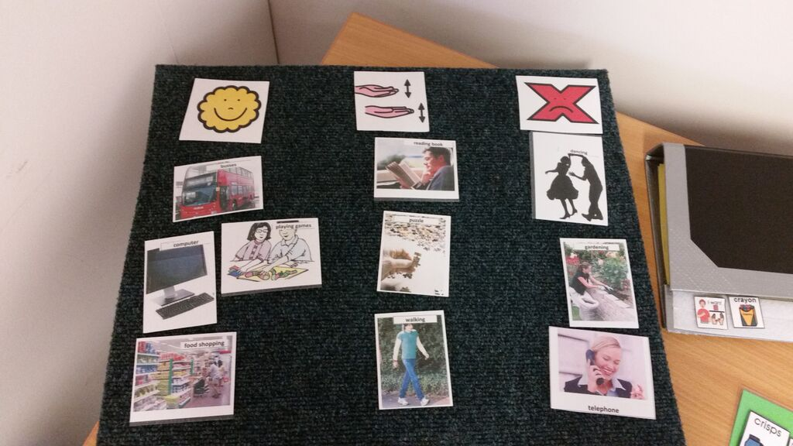

An Outcome is not an Intervention or a Solution

Slide 26

Outcomes matter!

Slide 27

They should be Aspirational…

Slide 28
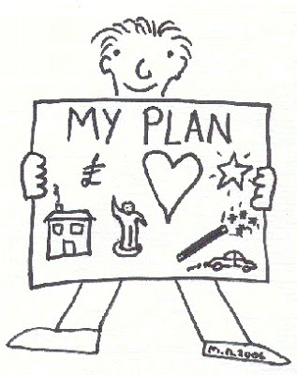
They should lead towards all the Life Outcomes…

Slide 29

They should be Holistic…

Slide 30
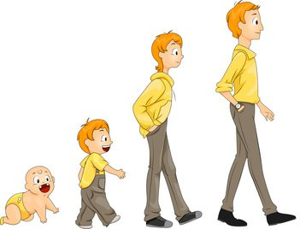
Of course outcomes, like children, will develop over time

Slide 31

Children, young people and parents should be involved in their development

Slide 32

Remembering that ….

Slide 33
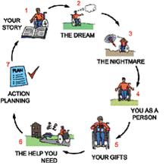
Outcomes must be based on Person Centred Planning

Slide 34

PERSON CENTRED PLANNING…..
A huge area
Lots of terms associated with it.
This clip shows how a person centred approach is essential to achieve the best plan/outcomes.
The EHCP will outline need,
outcomes, what needs to be put in place to achieve the outcomes,
who will do it, who is responsible
for doing it and who will pay for it.
https://youtu.be/8ElkB6NzWi8

Slide 35
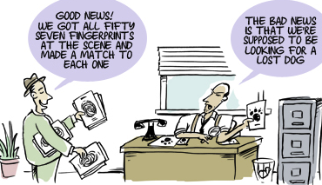
Only clear Outcomes will ensure the right Provision

Slide 36
Other Terms
Aspiration
Need
Provision/Solution
Targets

Slide 37
What are Aspirations?
‘A cherished desire’ or ‘Something to accomplish one day’
Aspirations might not be achieved in the end
The LA is not responsible for achieving aspirations but they must be set out in the Plan
Can be whatever the child/YP wants to achieve e.g. be a footballer/hairdresser/pilot/TikTok Star etc.
Help everyone better understand what motivates and interests them

Slide 38
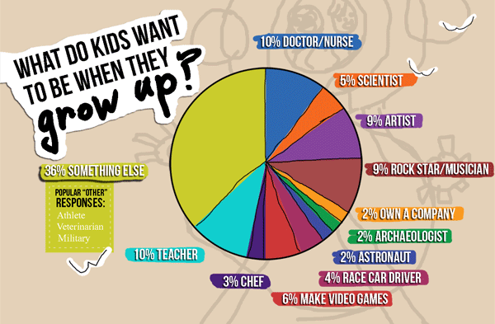
Aspirations……

Slide 39
What is a ‘need’?
Down Syndrome?
Inability to recognise letters and numbers?
Autistic Spectrum Disorder?
Learning Difficulty?
Difficulties with self help skills e.g. toileting?
All the above?

Slide 40
What is a Target?
Targets do not form part of an EHC Plan
They are short term and will be reviewed more regularly (usually termly)
Where they are set, they should be attached to the EHC Plan as an appendix, so that their impact on Outcomes can be considered

Slide 41
What is Provision?
The action of providing or supplying something… a service or resource
Examples:
‘participation in a social communication group with 4-5 other children, facilitated by a trained teaching assistant for 20 minutes, once per week’
‘James will receive one to one support in the classroom, for all lessons, to support him to understand and complete differentiated tasks’

Slide 42
The Golden Thread
Aspiration
Outcomes
Provision
Needs

Slide 43
“The Golden Thread” – Example I
Aspirations A | Needs B | Outcomes E | Provision F
Jenny (age 14) wants to get a job in travel | She needs to improve her spoken language skills | Jenny can give directions to another pupil so they can walk to another classroom in the school at least 100m away, successfully on 2 out of 3 occasions by the end of KS4. | 30 minutes small group (up to 5 students) language development programme, 3 times a week, designed and monitored termly by SALT with reinforcement activities in class. Jenny will be provided with a 2 week work experience in a local travel agency during summer term 2017, organised by head of KS4 in her school.

Slide 44
“The Golden Thread” – Example II
Aspirations A | Needs B | Outcomes E | Provision F
(At age 8) - Bob wants to be better at reading and be able to “read stuff”. | Bob needs to improve his phonic skills | Bob will be able to read a list of thirty 3-5 letter words with 2 and 3 consonant combinations, fluently, by the age of 11. | A phonics programme, delivered in a small group, 4 times a week, for 30 mins each time. Teacher to co-ordinate, with individual support from a teacher assistant to monitor progress at least every 5 minutes and provide prompts as needed.

Slide 45
What part do you play?
As a parent/carer, you will initially input into the EHCP Process by completing Part A with your SENCO or Independent Supporter
In part A the child/YP and parent/carers outline their Aspirations along with what is ‘important to’ and ‘important for’ their child/YP which should shape the ‘Outcomes’ discussion at the MA meeting

Slide 46
What part do you play ? (continued)
The Outcomes (Part E) will be discussed and agreed at the Multi Agency meeting that you will attend, with those working with your child/YP
This in turn will drive the provision your child/YP receives

Slide 47
Preparation…..
In order for you to confidently discuss/question/clarify those outcomes suggested by professionals and contribute to the process it is important that you:
understand what good outcomes are,
understand how they might be determined for your child/YP (they will be agreed at your MA meeting)
have the opportunity to think about them and discuss how they are structured with your Case Officer or IASS before the MA meeting
are clear about the impact the agreed outcomes in the plan will have on support/provision for your child/YP

Slide 48
Where to Start….
Think about where you want your child/YP to be, in terms of skills/development

Slide 49
In the Long Term
Looking into the future/adult life or in 5 or 10 years time
This is likely to influence your Aspirations in the plan

Slide 50
In the Medium/Long Term
To the end of a key stage/phase of education
This will help you focus on potential Outcomes for your child/YP

Slide 51
In the Short Term
By the end of the term/school year
These things can be fed into the development of short term targets
These form stepping stones moving the child/YP towards their outcomes

Slide 52
Ask Yourself…..
what you would like your child/YP to be able to do?
why you would like them to be able to do it?
what needs to be in place to achieve this?
what new skills they may need to develop to make it happen?
how can they be supported to achieve this?

Slide 53
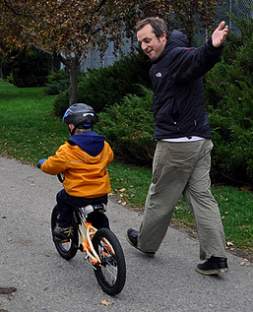
Ask Yourself (continued)
What would success look like?
How will you know when it
has been achieved?
Would you know it when
you see it?

Slide 54
Ensuring an Outcome is “SMART”
Specific & Stretch
Has a clear target: The what
Measurable (and Motivational)
Can be assessed objectively
Achievable but Ambitious
Is challenging but not beyond reach
Relevant & Realistic
Aligns with aspirational outcome
Is meaningful to the C/YP
Time bound (and Timely)
Has a time scale/end date
Can be achieved (at a stretch ) within the allotted time
Is well-defined and easy to understand: The why
Guides action: The how
Includes figures/numbers
Ensures that the C/YP has the ability to do this
Can be seen

Slide 55
Examples of Outcomes – Are They SMART?
By The time I go to secondary school, I will be able to go talk to my friends
By the time I am 10, I will be riding a bike without stabilisers
I will be able to travel to school and back every day, on my own.
Joe will demonstrate increased independence
At school, Mallie will be holding conversations with other children and adults, describing in simple detail things about her everyday life
In 2 years I will have improved fitness and stamina

Slide 56
Good Examples of SMART Outcomes
I will be able to travel independently, on public transport around Enfield by the time I’m 19 (& not with my parents)
By the end of the autumn term of Year 7 at mainstream secondary school, I will be holding simple conversations with my friends in the playground
By the end of key stage 4, Humphrey will be taking the bus to school twice a week without support

Slide 57
Aspiration to Outcome
YP aged 16 with:
a BMI of 12
poor feeding,
gastro problems/reflux & inflammation
of the oesophagus
Young Person: “It doesn’t hurt to eat, so I can enjoy my food”
Parent: “ I want him to put on weight”
SMART Outcome….
“By the time I’m 19, I’m eating comfortably and have put on around 2 stone”

Slide 58
Lets Make it Personal
Think about a key outcome for your child/YP:
Make a first draft (2 mins)
Discuss in your pair (5 mins)
Revise and feed back to the group for comment

Slide 59
Developing an Outcome…
By the time I’m……..(age or key stage)
I can/ have learnt the skills to/ am maintaining/ am doing………

Slide 60
Further Sources of Good Outcomes..
www.in-control.org.uk
www.preparingforadulthood.org.uk
http://www.youtube.com/watch?v=z3GJG6qlKys
https://contact.org.uk/help-for-families/information-advice-services/education-learning/ehc-plans-assessments/

Slide 61
What Next?
Did we cover everything?
We can answer individual questions at the end
Please complete your evaluation forms – we will shape future workshops with your feedback, so please help us improve it for other parents
We really hope you have found it useful
Let us know if there are any other areas in which you need support

