Slide 1
Understanding Behaviours in Children and Young People
Bexley CAMHS March 2020

Slide 2
How you understand your child
Warm up
Take five minutes to jot down
Your child’s diagnosis (if ok to) and / or needs
One of the main things you are struggling with
One thing your child is struggling with
One positive about how you are helping them
One positive thing about your young person
Back to that later …

Slide 3
Understanding behaviour
What do we mean by ‘behaviour’?
Behaviour in conditions - ASD, ADHD and LD
Recognising types of behaviour
Why are they challenging ?
What is their function ?
Understand your child’s condition and needs
ADHD ASD LD Comorbidities
Understanding behaviour
Three brains
Strategies and techniques
Other resources
Questions and answers
Chat and feedback

Slide 4
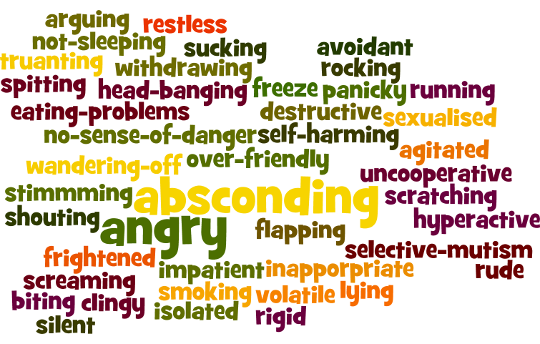
Understanding behaviour
We ‘re scared of what he might do next
I hate to see her like this
I don’t know where to turn to
I am not sure of what to do, it’s affecting her sister
I have to work out what’s wrong with him
Other people just don’t understand
It’s frightening
We feel useless

Slide 5
Behaviour in conditions - ASD, ADHD, LD
Aggression - verbal or physical or damage
Withdrawal or absconding
Sexualised behaviour
Self-injurious behaviour
Refusing to co-operate
Inappropriate behaviour
Repetitive questioning / over controlling
Spitting / scratching
Smearing / urinating
Over /under eating
Stealing food / stealing other things
Not sleeping / selective mutism

Slide 6
Recognising why behaviour is challenging
Danger to themself or to others
Worrying
Upsetting
Irritating or annoying
Embarrassing
Disappointing
Disgusting
Boring and repetitive
Exhausting physically and mentally
Impact on expectations and view of self e.g. I should deal with this better; They should behave; I should be able to manage; I should know what to do

Slide 7
Function of challenging behaviour
The majority of difficult behaviours happen for the following reasons:
An unmet primary need
Developmental needs ie LD
Fear and panic (aversion / avoidance)
Shame, anger, low self esteem
Control (PDA, compulsions and rituals)
Trust issues (blind / none)
High levels of anxiety *
Dysregulation of emotions
Sensory seeking or avoidance
A behaviour can serve different functions at different times
* more on that later

Slide 8
Function of challenging behaviour
The majority of difficult behaviours happen for the following reasons:
To gain an object goal or item
To gain or maintain social interaction
As a form of communication
For sensory stimulation
To avoid a stressful unwanted situation
It’s important to learn as much as you can about your child’s condition.
With that in mind let’s revisit: ADHD, ASD and LD in relation to behaviour.

Slide 9
Understanding ADHD
ADHD is a neurodevelopmental disorder affecting both children and adults.
It is described as a “persistent” or on-going pattern of inattention and /or hyperactivity-impulsivity that gets in the way of daily life or typical development.
There are three presentations of ADHD:
Inattentive
Hyperactive-impulsive
Combined inattentive & hyperactive-impulsive
(DSM V)

Slide 10
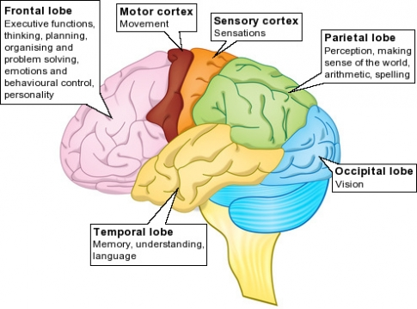
The ADHD brain
Cortex: Is involved in memory, attention, thought and language
Thickens as you grow in the teenage years
ADHD: Cortical thickening is slower in the frontal and temporal areas
It affects behaviour regulation and memory
The neurotransmitters Dopamine and Noradrenaline are the main chemical messengers, however communication within the brain is impaired

Slide 11
Symptoms in ADHD
Inattention: | Impulsivity: | Hyperactivity:
Makes careless mistakes | Talks excessively | Fidgets/squirms in seat
Struggles to sustain attention in tasks/play | Blurts out answers | Gets up from seat or leaves classroom inappropriately
Doesn't listen when spoken to | Difficulty waiting turn | Runs or climbs excessively
Not following through instructions, or not finishing work/tasks | Interrupts or intrudes on others | Struggles with quiet play
Difficulty organising tasks/activities |  | "on the go" as if "driven by a motor"
avoids, dislikes, or is reluctant to engage in tasks that require sustained mental effort (e.g., schoolwork or homework
Often loses things
Often distracted by what's going on around them
Forgetful in daily activities

Slide 12
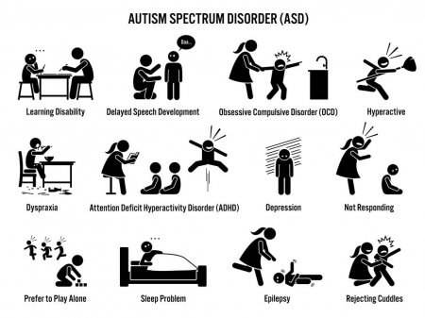
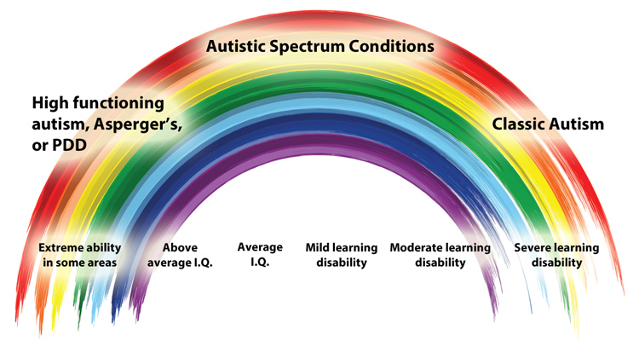
Understanding ASD
Autism: Persistent difficulties with social communication and social interaction and restricted and repetitive patterns of behaviours, activities or interests since early childhood, to the extent that these ‘limit and impair everyday functioning’.
https://www.autism.org.uk/about/what-is/asd.aspx

Slide 13
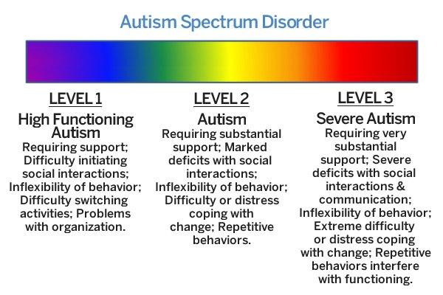
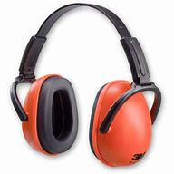
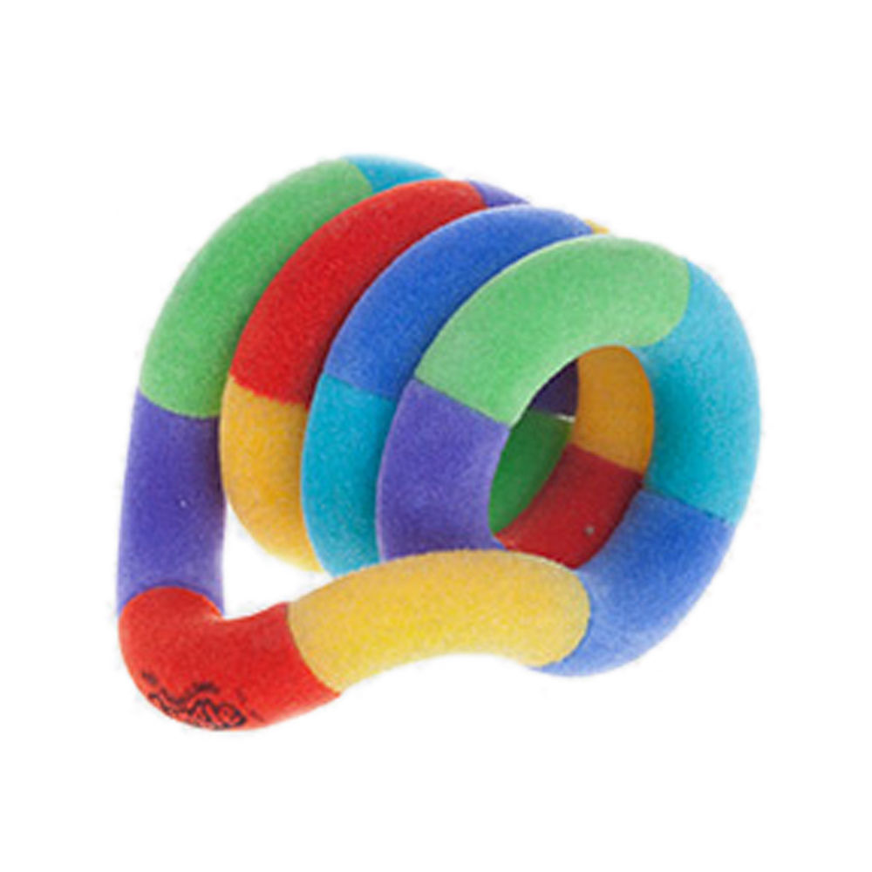
Your ASD child’s behaviours
Different behaviours at school and home
It's quite common for autistic children who do not appear to have any behavioural difficulties at school to behave differently at home. Tony Attwood refers to this as the Jekyll and Hyde character (Attwood, 1998).
Challenging behaviour
Some autistic people can display challenging behaviour. It includes what would normally be considered physically aggressive behaviour, but can also include other behaviours if they have a negative impact on the person or their family.

Slide 14
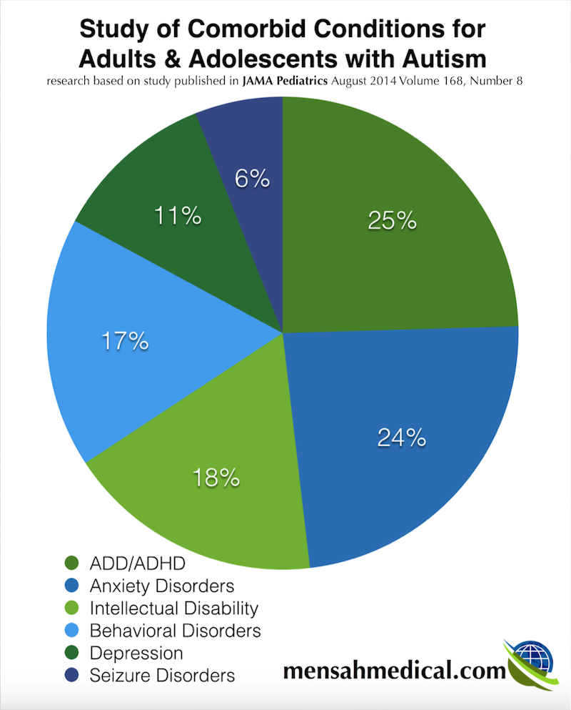
ASD comorbidities and behaviours
https://youtu.be/Ezv85LMFx2E Amazing Things Happen

Slide 15
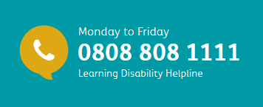
Learning disabilities LD
What is challenging behaviour?
'Challenging behaviour' sounds like a broad term, and it is.
Challenging behaviour describes behaviour that is challenging to parents, carers, teachers and other professionals.
Challenging behaviour and LD
Challenging behaviour is not a learning disability, but people with LD are more likely to show challenging behaviours.
This can be due to people having difficulty communicating.
Challenging behaviour can be a sign that something is wrong like pain or discomfort that your child cannot express to you.
Challenging behaviour can also be a sign of wider problems, including mental health.

Slide 16
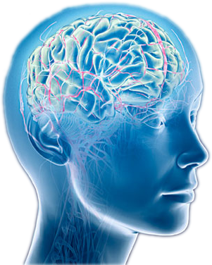
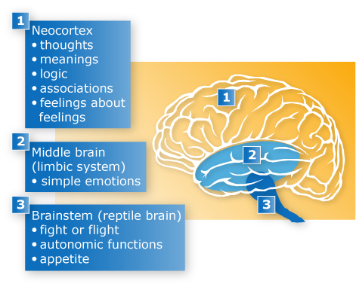
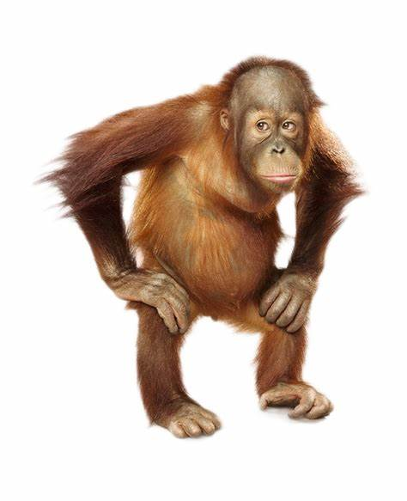
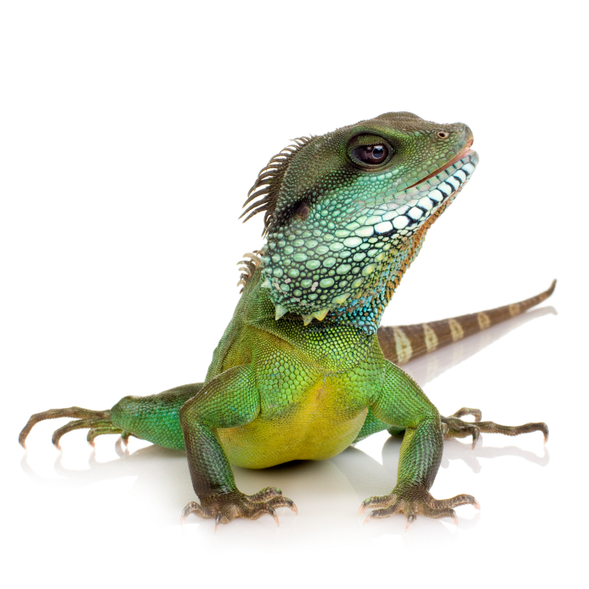
The driving force behind behaviour
The three brains
Executive brain
Mammalian brain
Lizard brain

Slide 17
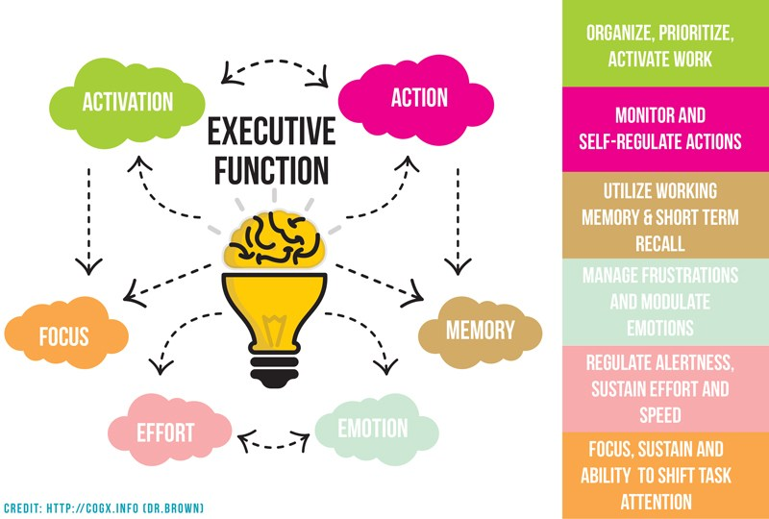
The driving force behind behaviour
The ‘control tower’ executive brain

Slide 18
The driving force behind behaviour
The limbic system – linking the two other brains
Feelings and reacting to emotions, motivations and memory (filtered)
Amygdala - where memories are stored, the heart of
our emotional responses and reactions at a basic level (fight, flight or freeze)
Hippocampus - for long term memory and retrieval
Hypothalamus - the body’s thermostat regulating breathing, BP, temperature, hunger / thirst, sleep / waking

Slide 19
Fight, flight and freeze
The lizard brain
The ‘brainstem’
Involved with basic responses Fight Flight or Freeze
Everyone feels anxious from time to time. In fact, feeling anxious can be our brain’s way of protecting us. But what happens when inexplicable anxiety becomes uncontrollable and takes over your life? The Fight Flight Freeze response: is our body's automatic and primitive, innate response that prepares the body to "fight" or "flee" from our perceived attack, harm or threat to our survival. Sometimes, though we perceive threat or harm when in reality, things are totally fine.
https://lnkd.in/dCrGWY5

Slide 20
Fight, Flight or freeze

Slide 21
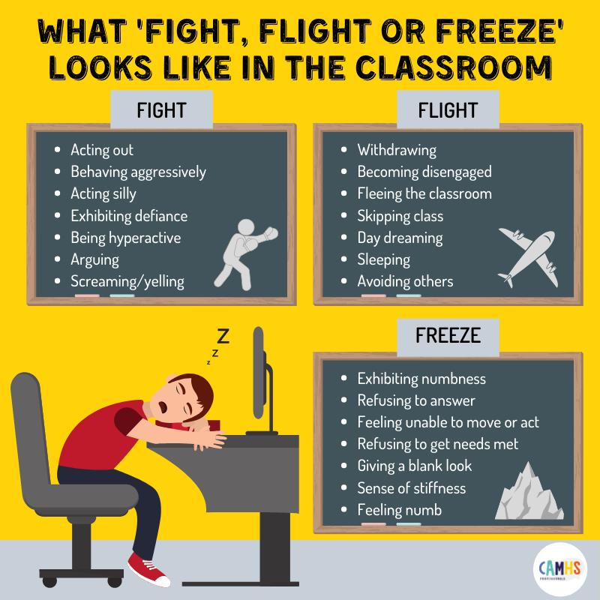
Challenging behaviours in school
How does this translate into what’s happening at school ?
How different is it at home compared to school ?
How do school understand the differences ?
What can you do to help your child’s anxiety ?

Slide 22
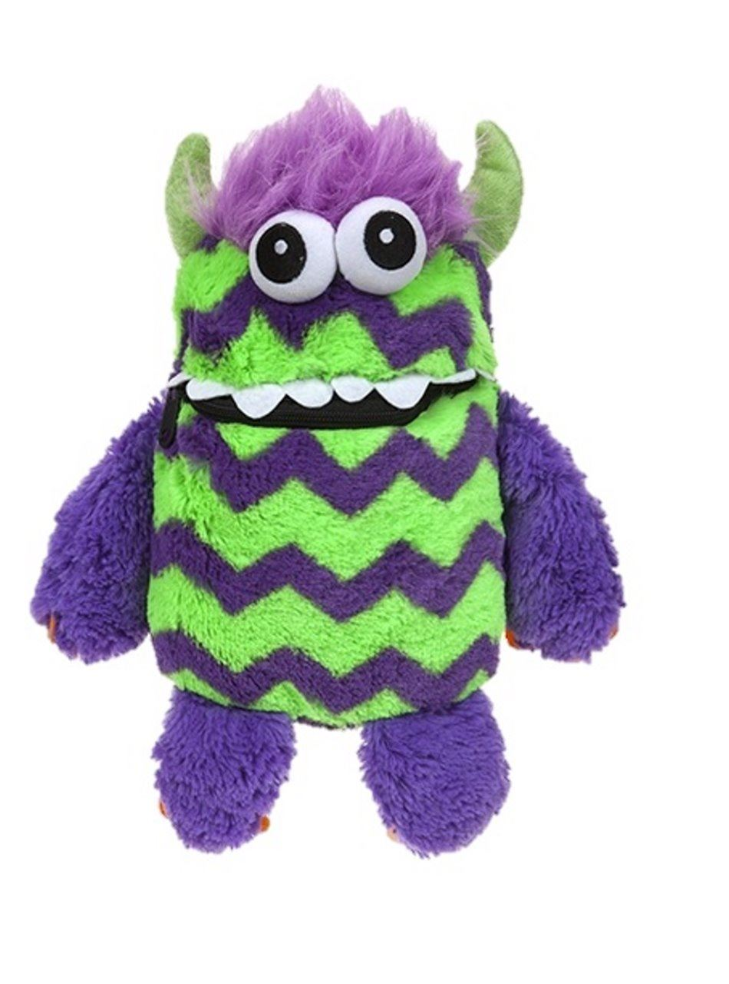
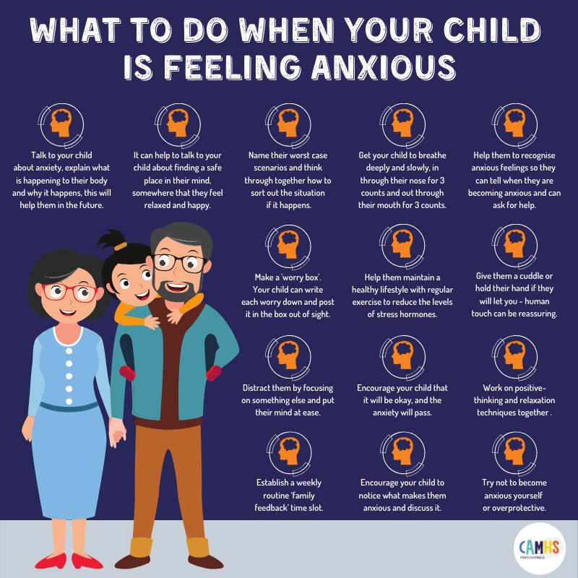
How to help your child with anxiety
The worry monster

Slide 23
Working out what’s going on
What happens exactly? Rate the problem out of 10. When does it happen? When does it not happen? Who does it happen with? Who doesn’t it happen with? How often does it occur? What makes it less frequent? How long does it go on for? What can reduces it?
Setting Trigger Action Response

Slide 24
Some strategies DOs
Stay calm
Help in the heat of the moment by naming the emotion. E.g. “I can see you are really angry right now”, “You look furious”
Validate their emotion – I think you feel…, that’s ok/understandable and I want to try to help you
Listen without judgement – do you really understand how your child feels and why? Even if you don’t agree!
Give simple choices to help redirect the behaviour
Give a cool-down period, calm-down activity, or encourage participating in a physical activity - it’s okay not to talk (especially in detail) and is usually better to let the situation cool down before trying to make sense of it/reason a different response

Slide 25
Some strategies DON’Ts
Don’t expect them to hear / respond to you immediately
Don’t order them to feel differently
Try not to retaliate or escalate the situation
Don’t force a child to apologise when they don’t feel sorry (approach after cooling off and later support them to understand the impact of their behaviour)
Avoid labelling e.g. ‘bad’ or ‘good’ or ‘naughty’

Slide 26
More Strategies - ASD, ADHD and LD
Use visuals to support understanding e.g. visual timetables coloured cards, emotion faces, scales, now and next
Be more concrete, use clearer language
Check understanding of language (your child may not get metaphors)
May need to use their special interests as a way in
May need to be more directive e.g. if… then …
Emotional awareness training and or social skills support
Social stories (Carol Gray) https://thegirlwiththecurlyhair.co.uk/
Comic strip stories (Alex Kelly) Change and engagement can take a long time - please don’t give up!

Slide 27
Sensory Strategies

Slide 28
The impact of not enough sleep
Not getting enough sleep can affect:
Our mood
The foods we eat
How we respond to things
Our learning
Our health
Melatonin: Is the hormone that tells our brain it is time to go to sleep
Cortisol: Is the hormone that tells our brain to wake up and be alert. It is also known as a stress hormone.
These two hormones cycle throughout the day / night. Increased cortisol (stress/worry) can impact on sleep onset.

Slide 29
So how can we help with sleep?
What can help? Having a set, predictable routine, with wind-down time
Agreed timetables or expectations - good sleep hygiene
Relaxing activities: colouring, drawing, listening to relaxing music, mindfulness, breathing exercises, yoga
Try things like lavender oil, weighted blankets, sensory lighting
Working out a new bedtime routine
What time do you have to leave?
How long does it take you to get ready?
How many hours sleep does your body actually need?
Add 1 hour wind-down time
Bedtime

Slide 30
Positive Behaviour Support
PBS Example
Antecedent Behaviour Consequence

Slide 31
Overview of strategies
Try to be aware when a child is likely to be emotionally upset, or is getting angry, anxious or low
Use a feeling thermometer, or traffic light system, to avoid a build up or over-reactions to their emotions
Notice when your child is doing well/what has been asked and PRAISE, PRAISE, PRAISE, IF APPROPRIATE (some children find praise very challenging and it can have the opposite effect!)
Encourage the child to take ‘time-out’ to calm down
Develop their self-esteem - give age appropriate responsibilities
Good communication between adults - role modelling is important!!
Set clear expectations i.e. what it is, and how; I expect you to speak to teachers calmly and politely
Try de-escalation techniques
Try reward charts

Slide 32
Positive Behaviour Support ABC
Often when an incident has happened, it is easy to react to the outburst. Think ABC
A- Antecedent: What happened before?
B- Behaviour: What did the child do?
C- Consequence: What happened after?
Breaking an incident down, can help to identify the trigger, and learn break the pattern.
Often children with ASD hold on to events that happened earlier in the day, with an outburst several hours later.
Often children with ADHD can be more reactive and immediate in situations.
Helping your child to break down their feelings and causes, can help them with identifying and regulating where their emotions come from and why.

Slide 33
Become a detective
It is key to understand what is driving your child’s behaviour.
Don’t just deal with the behaviour, try to find and understand the triggers.

Slide 34
Recommendations and resources
Support for parents
Post diagnostic workshops
Bexley Local Offer
Advice
Events
bexleyvoice@hotmail.co.uk BEXLEY VOICE
NORMANDY CHILDRENS CENTRE FAIRFORD AVENUE, BARNEHURST KENT DA7 6QP Helpline 07512 409 936 (Thursday)

Slide 35
Local resources

Slide 36
Local support networks
Bexley SNAP
Normandy Children's Centre Fairford Avenue Barnehurst DA7 6QP
Telephone: 01322 334192
Email: admin@bexleysnap.org.uk
Bexley has an Autism Hour interactive map: www.autism.org.uk and you can find more information about permanent quiet hours via Bexley Local offers.
Beavers swimming club for people with learning difficulties– Fridays 6-7:30pm Crook Log - 0203 393 8305
Cinema screenings – aimed at autism https://www.dimensions-uk.org/get-involved/campaigns/autism-friendly-cinema-screenings/
Morrison’s - Quiet hour takes place every Saturday from 9 to 10am. Dimmed lights , no music, avoid tannoy, check beeps and other electricals turned down, poster is placed out side to inform customers of quiet hour.
Sainsburys: Monday morning, Wednesday afternoon and Saturday Morning.
Entertainer, COOP and Marks and Spencers stores have some quiet slots
INTU shopping centres – Reportedly all staff are trained in supporting those on the spectrum
Chewigem.co.uk (sensory chewing materials)
Bexley Enterprise College (a range of free family courses to support school learning) 0203 045 5176

Slide 37
When dealing with behaviour
Don’t panic ! (try not to)
Understand and identify patterns
Keep a record / diary and look out for triggers
Give yourself marks out of ten for how you manage (it will vary)
Good day, bad day, somewhere in between?
You know your child and know when something is wrong
Consider PBS and other helpful strategies (NVR)
Know when to get help and where *
* Bexley Voice and others local services can support you

Slide 38
Final thought
Take 5 minutes to think about the things you wrote down earlier
Share your jottings with someone next to you (if you’re ok to)
Is there one thing you’ve picked up today you think may be useful?
Do you think you understand what is driving their behaviour ? (or yours)
Comments or questions ?
Please use what you have learnt if you can Please help us improve by leaving feedback Please think what you’d like to see in future workshops

Slide 39
Useful links
Other places for information
The Girl with the Curly Hair Alys Rowe (clips) Limpsfield Grange https://limpsfieldgrange.co.uk/autism/links/ (for PDA)
Cerebra on Behaviour https://cerebra.org.uk/download/factsheet-managing-challenging-behaviour/ (also has links for sleep, ‘mythbusters’ and advice on DLA) The Little Black Duck www.thelittleblackduck.com.au
https://www.challengingbehaviour.org.uk/
https://www.nhs.uk/conditions/social-care-and-support-guide/caring-for-children-and-young-people/how-to-deal-with-challenging-behaviour-in-children/

Slide 40
Thank you for participating
Dr Alexandra Oxley Bexley CAMHS LD ND

