Slide 1
Introduction of the
Quality First Teaching and
Special Educational Needs Toolkit
Notes:
Welcome to everybody to our QTF and SEN Toolkit training.
Today, Cathy Palmer and I will be delivering training on the Quality First Teaching and SEN support Toolkit.
Cathy and I are SEN Strategic Support partners who work for the Bexley Early Intervention and Specialist teacher advice Team. We have both been Sencos in Bexley.
You will need a copy of the Toolkit to access this training.

Slide 2
In total how many pupils are educated in our mainstream primary and secondary schools? (Census data May 2021)
43,393
Notes:
How many children and young people are educated in Bexley?
43,393 - Many of the strategies suggested in the Toolkit benefit all children, so we include this figure as the toolkit is not just for those children on SEN support but will aid ALL pupils across the borough, through using QFT strategies and identifying needs early.

Slide 3
How many EHC Plans does Bexley have?? (census data May 2021)
1527
Notes:
We usually ask attendees to consider how many education health and care plans Bexley have issued. As this is pre-recorded training we would asked you to consider this briefly before we share the number with you.
1527 – these are the pupils that have the highest need in our schools and have additional high needs funding.

Slide 4
How many children & YP in Bexley are on SEN Support?? (census data May 2021)
4721
Notes:
How many children and young people are deemed SEN support in Bexley? Again, we would normally ask you to discuss or estimate how many of our children are recorded on the SEN register as K.
The total number recorded on the May 2021 census data is 4721. Did you expect that many young people to be at SEN Support?

Slide 5
What is the biggest primary need for pupils on SEN support? (Census data: July 2020)
1st Place……
Speech, Language and Communication Needs
2nd biggest need…...
Social, Emotional Mental health
3rd biggest need….
Specific learning difficulty
Notes:
Pupils on SEN support are usually categorized into the 4 main areas of need as per the SEN CoP. Their primary need, as in the area causing the main barrier to their learning, is recorded on your school data system.
In first place, is SLCN – this includes pupils with a diagnosis of A-S-D-
In second place is S-E-M-H- needs, this includes pupils with a diagnosis of ADHD
In third place is SPLd, this may encompass dyslexia, dyscalculia dypraxia etc.
You may be able to identify these rankings with the needs you see in your classes.

Slide 6
EYFS Primary and Secondary Post 16
Notes:
As you can see, Bexlet Early intervention team has produced 3 toolkits. One for our youngest pupils, be they in nurseries, pre-schools or childminders, one for primary and secondary pupils up to the age of 16, then a separate document for Post 16 young people.
All 3 TK’s have been written with a large number of professionals; from SENCO’s who were instrumental in creating the support plans to our many multi agency services such as Educational Psycologists, speech and language therapists who heavily supported the strategies section.

Slide 7
Hot off the Press!!
2nd Edition!!!
Metacognition
Parents strategies
Reading
Writing
Spelling/phonics
Maths
Resilience
Wellbeing for adults
Wellbeing for children
Notes:
The first Toolkit was published in July 2019. In September 2021 it was decided that the Toolkit should be updated to reflect the impact of Covid 19, by including additional strategy sections for resilience and the mental health and wellbeing of adults, children and young people.
The updated Toolkit was published at the beginning of March 2022 and all schools have been given multiple copies. There are an extra 26 pages of strategies which include the following areas:
Metacognition
Parents strategies
Reading
Writing
Spelling/phonics
Maths
As well as Resilience, wellbeing for adults and children as previously mentioned.

Slide 8
What are the QFT and SEN Toolkits?
It’s a document for class teachers and support staff which recommends strategies to meet pupils needs, in the first instance, as part of quality first teaching and good classroom practice.
It is a guide to help recognise early barriers to learning and to support consistent identification of special educational needs.
Notes:
At this point we would ask to you to look at your Toolkit documents and flick through them. You will see that they are a guide for ALL school staff – that’s teachers and support staff to meet the needs you have identified in your class. The Toolkit provides provides easy strategies or top tips that should be in place with your QF classroom teaching – basically, these are good classroom strategies.
The toolkit is to provide you with a guide to help you recognize early barriers to learning and make it consistent throughoutall schools in Bexley.

Slide 9
Why do we need the toolkits?
To put the emphasis back to quality first teaching and good classroom practice.
Consistency in identifying SEND needs.
All staff are responsible for supporting pupils with SEND.
Pupils needs are identified early.
Notes:
Why dis Bexley produce the QFT and SEN Support Toolkit?
The Toolkits were created to provide clear strategies to teachers and all staff involved with supporting children and young people and to ensure that there is consistency in approach and identification across all Bexley schools.
The idea is that strategies are in place and needs are met as early as possible even before SEN is raised as a possibility with the Senco.

Slide 10
Support given should be in line with the pupil’s needs and not dependent on diagnosis.
Schools monitor the impact and effectiveness of support and interventions through the graduated approach.
Parents will know what support they can reasonably expect to be provided.
Notes:
Continuing with the heading of why we needed the Toolkits …
At this point, it is important to know that support given is to meet the needs of the child or young person and does not depend on a formal diagnosis. Needs will have been identified well before a referral and diagnosis have been given and support should already be in place.
The CoP requires schools to take a graduated approach to supporting children and young people - this will be explained later in the training. Teachers, LSA and Tas provide the first tier of the graduated response though QFT.
As teachers, we all know that many parents, especially those of pupils with SEN, will want to know how their children and young people are being supported in the classroom. The Toolkit will help parents to know what they can reasonably be expected to provide in the classroom.

Slide 11
Page 6 – 8 Legal obligations
Notes:
This session in all 3 toolkit explains the legal responsibility of all school and college members, taken from all relevant legislation. We have taken key pieces of information that we feel settings, teachers, staff and parents would need to know and also who is responsible in delivering the support to the children and young people. For example SEN support, the CoP states…….

Slide 12
Notes:
This page is the heart of the document and is how we recommend educational setting identify SEN. WE have used the same cycle through all 3 toolkits.

Slide 13
Notes:
In this section we heavily use the gradauted appraoch. This means assessing – looking at what the pupil is struggling with, PLANNING – stettiong SMART targets and intervetyions to support the gaps in learning – DOING – carrying out the support for a set period of time – REVEWING – was the support successful, what was the impact for the child? Does the child need further support or has the current support been adeqaute enough?
So loloking at the first stage in this cycle this is where the pupuil, parent carer or uourslef may identify a barrier to learning whether it be emothopnal, educationally – socially or physical.
These barruers have ebben dientofied early so at this stage would would receommned using the startgteis in the startgeis section on page 12.

Slide 14
Notes:
In all 3 toolkits you acb see that the startegeis are set out in areas of need and not diagnosis. However in the EFYS one which we will show you in a couple of slides it is set out specifically around the EYFs areas of development, which makes it even more specific and relevant to the little ones. AS you can now see the extra sections have been included.

Slide 15
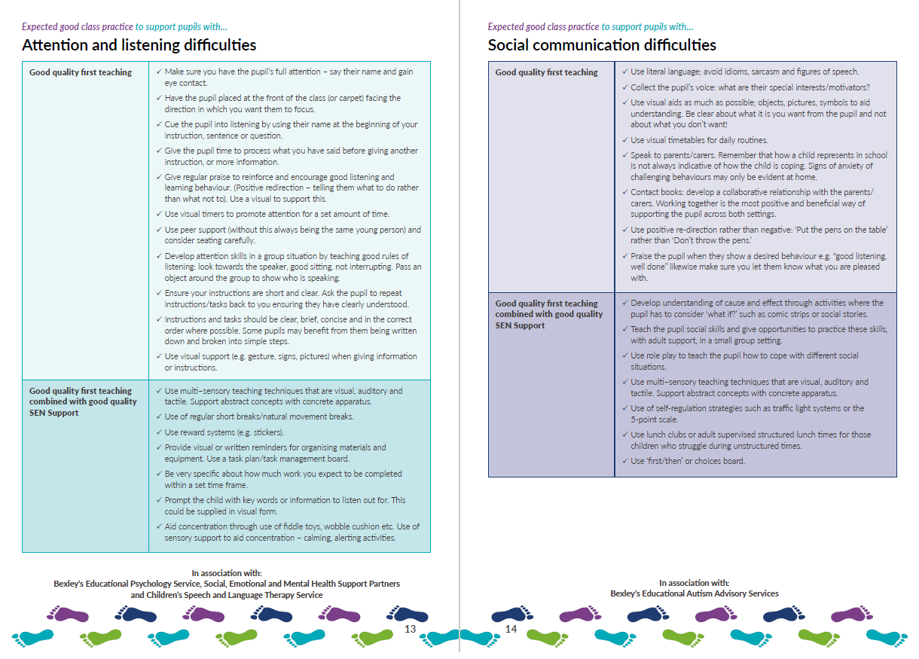
Notes:
These have all been written in conjunction with various professionals as stated at the bottom. Therefore if a child or young person was presenting difficulties in the areas of attebntion and listening we would expect some of these strategies to be tried in the first instance. you may only want to try 3 or 4 of the strategies whilst keeping a very close eye on wheteher they are effective for the child or not. If they are not working, stop the strategy and try another one. What might work for one pupil may not for another.
So for example if you have a child who is struggling with attention and listening you may wish to try a couple of strategies on the list such as " using a visual timers to pronote attention for a set period of time" and a second strategy of "instructions should be clear, brief and consie and in the correct order of possible.
Its seems very simple but giving a pupil a set amount of time, for example 15 mins, and clear instructiosn that wyou want te m to cpomplete the forst 8 questions or you would like them to read u[ to the end of the chapetr helps them in that it realy enforces what your exepectsion are and within what time frame.

Slide 16
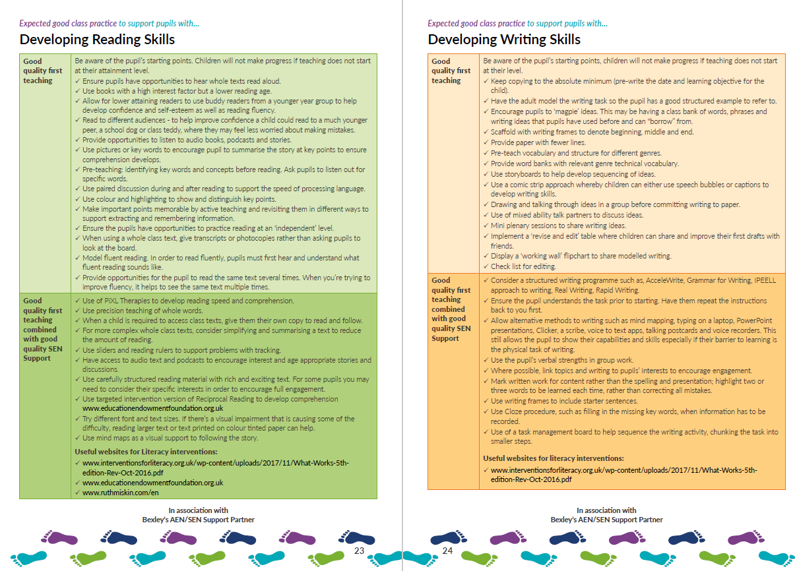
Notes:
Here are the new sections on developing reading and writing skills.

Slide 18
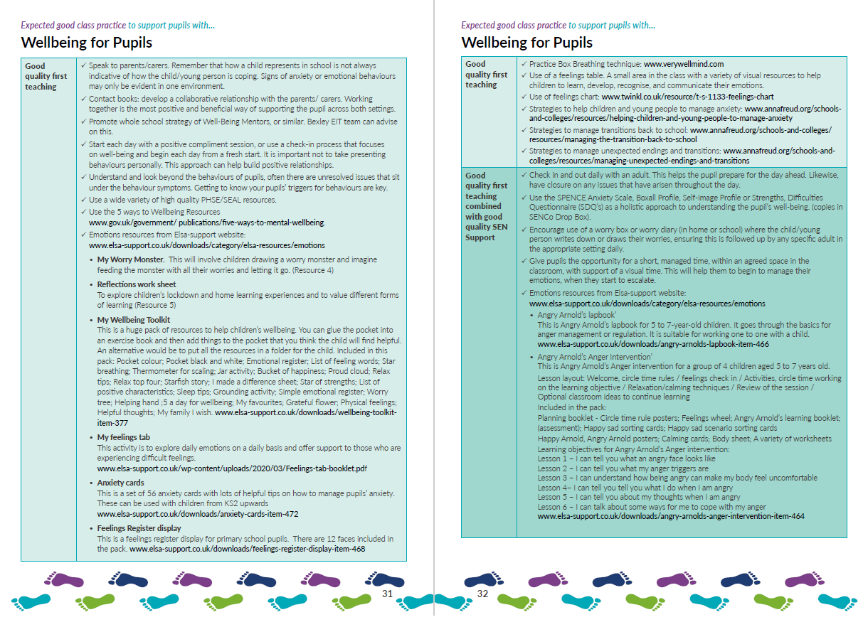
Notes:
Here is an example of the 2 pages on pupils well being. Again very simple strategies yet ext6reme;y effectoce. For the well being section we collaborated with Elsa –support. On tehir website they have many brillinat and free respurcse. Some of these resources we have included in the toolkit so you can either photociopy them or ask you senco fro an electronc copy.

Slide 19
Notes:
Here is how the EYFS one is set out. As you can see rather the stargeies are absed around the EYFS curricukum

Slide 20
Notes:
This is the page fro children exepereinceing diffcities in using langaue and speech sounds. These startegoes have been created to be very speciific for those children under 5.

Slide 21
5 minute task:
Pick 2 areas of need and read through the strategies suggested.
What do you like?
Are they manageable?
Notes:
Whether you have the EFYS or main TK in front of you take 5 minutes to read 2 areas of need and the strategies suggested . Think about What did you like about these? Do you feel they are manageable?
5 mins

Slide 22
Strategies Guide pages 12-23
“Luis cannot work independently. He needs a TA to get anything done”
5 minute task:
Using the strategies guide:
What areas of need should be considered?
What strategies will you try BEFORE raising this child with the SENCo?
Take 5 minutes to read through these pages.
Notes:
We can all relate to a Luis in our working world, regardless of his age. Again using the strategies section what areas of need would you consider for Luis and what strategies will you try before raising him as a concern to the SENCO?
5 mins
Hopefully you loked at a variety of areas of need for luis. We don not ave enough infprmation about hi as yet to know sepcifiaclly why he is unable to work indepanetantly. It may be something is going on at home, a recent bereavemnet, parental split and that is effceting him in school;. It may be a underlying eductaional or speecha nd langauge issue. Either way we hoped you found some strtegeis across a nyumber fo ares of need wihich you feel would have been suitable to tyry in the firts instance. .

Slide 23
Notes:
So going back to our fusrt stage of the cycle,. Once you have tried and implemnetd the startgeis you need to review then as stated. If you feel they wprked and that no further support is needed that is great and just continue to use them for as long as the pupil requires. It may be that you feel some starties have worked by the pupil is still not makinga s much priogress as you would like. It is at this point we would move on to the secondat satge – class based support with SENCo advice.

Slide 24
Notes:
So if you feel insuffienct progress has been made and you still have concerns then we move onto the next stage. This is the only part of the cycle which is slightly different for EYFS. We have not recommend that EYSF settings use a “early identification of need sheet” purely because communication with parents, carers and EYFS staff is generally daily due to the nature of being in a much smaller setting. We still recommend that the nursery workers take SENCo advise at this stage but have not recommended a specific form for you to complete. If you are a Nursery setting attached to a primary school then the SENCO ay well encourage use of this form.

Slide 25
Notes:
This is the only part of the cycle which is slightly different for EYFS. We have not recommend that EYSF settings use a “early identification of need sheet” purely because communication with parents, carers and EYFS staff is generally daily due to the nature of being in a much smaller setting. We still recommend that the nursery workers take SENCo advise at this stage but have not recommended a specific form for you to complete. If you are a Nursery setting attached to a primary school then the SENCO ay well encourage use of this form.
This is a dicumet we have encouraged schools to use. You amy recognise it or have something sinilar in your school. both the primary and sec0nadry ones are very similar but the way the progress and levels are set out is slightly different liskewise, seconadry schools often use rund robins as pupils have more than 1 teacher. In this sectionw e odu exepect you to say
What your concersms arewhat the parents carer and pupil concrens are
What strtegeis you have tried so far and what has the ipact been,
What resources if anyu you have given the child to use and the inpact of these. For example you may have goven them a fiddle toy and that has helped to increase conecrtration or it wasn’t succesful at they kept thrpwing it across the room
And what n class intervetions you have treied. It may be the pupil reda to you daily but striggeled each day to remember key words or phonic sounds fro the day before. You would then give this form to the senco and they will reply.
It may be that the senco comes back wth some more bespoke resurces or startegeis fo ryou to try. It may be that they ahd a quick book look and receommend you differentied further for this chikd over the next 6 weeks and then report back to the senco regarding the imact of this.
It may be that the senco does a clasrron and social observation of the chidl

Slide 26
Notes:
At this sate the senco may advse you gove furer support and measure impact over a set period of thim or trhey may also agree that there are a number fo concerns and move on tho the next sattge of our cycle.

Slide 27
Notes:
At this stage of our cycle we are now at SEN support. The code of practces defgines esn support as when a pupils is requires support above and beyond that of tehir peers.
Legally parents and carers need to be formally infomred of their cild being placed on the SEB register. We interput formally as written and not simply telling them at the school agte.

Slide 28
Notes:
This is an example of one of the SEN support plans in the primary to secondary TK. EYFS have something very similar. The principle is the same regardless of what KS you are working in – its all about evidencing support given via the graduated approach; by assessing need, planning how to support, implementing the support and then reviewing impact. Like wise you can see that we have included parent/carer, pupil and setting voice.
Hopefully you have somethig very similar in your school or setting we hve encourage scholl to oersonalise thse with tehir own logos etc to make it a working documents for you and the pupil.

Slide 29
Notes:
We know that many of our Bexley parent/carers feel that communication between home and schools/setting is inconsistent. We are hoping that this will also help improve communication and are encouraging all EYFS, primary secondary and colleges to share this support plan with parents is they can actually see what support their child is getting in order to help close the gap, how they are receiving this and the steps of progress that the child / young person is making.

Slide 31
5 minute activity
Take 5 minutes to read through any of the examples of the SEN support plans:
EFYS page 19
Primary and secondary page 46 –53
Post 16 page 34
How do you think these will be helpful for the pupil/parent/carers your school/setting?
Notes:
5 mins

Slide 32
Notes:
So after implementing the support on the support plan this would be reviewed with the SENCP, class teacher and parent/carer and maybe the pupil too. If it is agreed by al lthat the support goven so gar is working it may be that the pupil can remain on this level of support, may need the next satge intervtion above, or may not need any support at all with means they canc ome off the SEN register and just be montored in the class.
If it is felt that some progress has been made by theer are still concrens then we woudl move on the next next satge of the cycle.

Slide 33
Notes:
This is similar as it is still sen support but there would now be exetrenal ageny inviolebmbt. It may be that as speech and langauge referall has been made. A referral to the community PAediatrican. Perhaps on of our EP's or other spoeickst advise staff have come and obersved the child. The childs support with still be monitired via an SEN support plans but what ever advise or startegeis the exyteral agency has given these would aslo be included on the plan. Again these atrgets and support pland should be reviewed every term. Hopefully at this stage peogress is being made but if not then the SNCO may wish to consder applying for an EHCP and would diccuss this weith our team at their termuly EIT meetings.

Slide 34
New in the post 16 Tooklit
Notes:
If you have a copy of the post 16 toolkit in frint of you this section ahs been inlcuedd. We would encurae schools to be using this section for puipuils from yaer 9 onweards. FOr some pupils they may not want to follow the obvuioiusl route of alevels and univrsties and we feel that there is not a clear or direct way to access informatio about what to do afer yaere 11 if this is not your plae. We have hoped thatw e have created a one stop shop where all aspects of tranistsioning to adulthood for any pupilWITHOUT an EHCP.

Slide 35
Notes:
As you can see we have inclueded sectoipms on education, emplyemnt including futher edciation providersa nd apprentiships.

Slide 36
Notes:
It may be a pupils is very abvle but suffers from menatl health issue. Again we have included a section to support this.

Slide 37
Notes:
We felt is was importamt to include a section on identy. It is something that is being dicussed more and mpore in our schools. It may be that a pupils is questioning their sexuality or gender but feel they cannot speak to anyone as yet. We are hoping that this sectioncan signpost them to organistions that can support im the first insatnce.

Slide 38
Thank you!!
If you have any questions please ask your SENCo.

