Slide 1
Moving into year 7…..
2020
From kids that know!

Slide 2
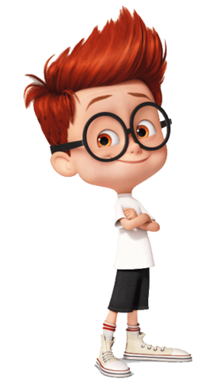
Getting to school
Top Tips……
Apply for your oyster card now.
Always pack your school bag the night before.
Plan and practice your journey.
How will you get to school?
How long will it take you to get to school?
What time will you need to get up?
Apply for an Oyster card now.
https://tfl.gov.uk/fares/free-and-discounted-travel/11-15-zip-oyster-photocard

Slide 3
Making friends
Top Tip…have a look on your school website to see what clubs they run, which you may want to join.
You may already know people from your old primary school, but its still good to make new friends.
Look at what clubs you can join at lunchtimes or after school.
Look at what clubs you can join outside of school.
Remember you are not the only one who doesn’t know many people!

Slide 4
Homework… it’s boring but we all have to do it!
Get yourself into a good routine from the start.
Write your homework in your planner along with the date it is due in.
Come home, have a drink, change out of your clothes, then settle down for an hours homework.
If you can, have a set area at home which is quiet and away from distractions like the TV or Xbox.
If you are spending too much time on homework and are finding it hard, tell your form tutor or teacher.

Slide 5
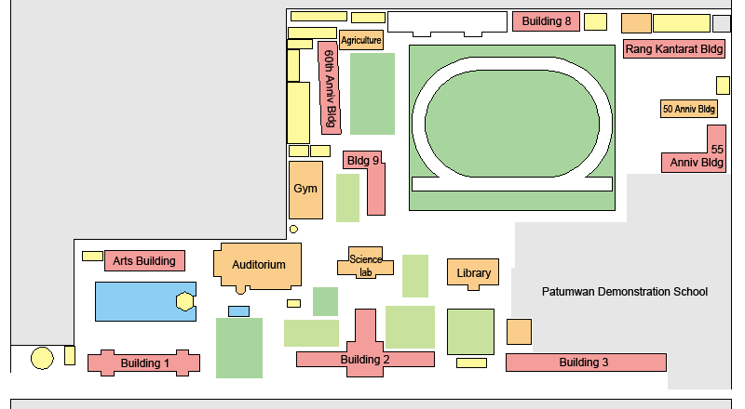
What if I get lost around school?
You are bound to get lost at some point particularly when moving from one classroom to another.
Stay with friends from your form or those you have lessons with so you can help one another find your way around school.
Ask teachers where rooms are.
If you are late to a lesson because you couldn’t find the classroom, do not panic!
Remember: No one in year 7 will know where they are going!

Slide 6
Phones
Top Tip: Put your adults number in your friends phone, and put their adults number in your phone. This way if you loose your mobile or it runs out of battery then you can still contact home using your friends phone.

Slide 7
What if I need extra help?
Listen to…
George’s Story

Slide 8
What if I need extra help?
Listen to…
Shannon’s Story

Slide 9
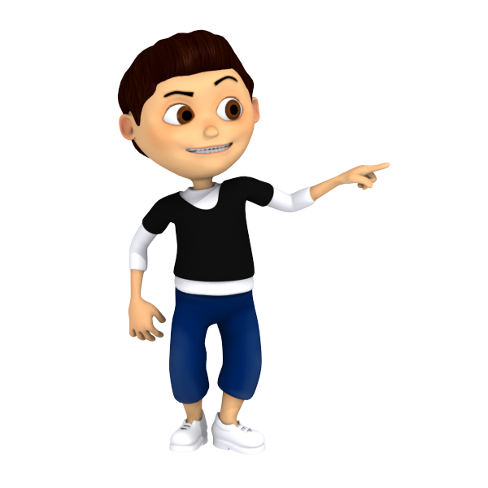
What if I need extra help?
Listen to…
Coben’s Story

Slide 10
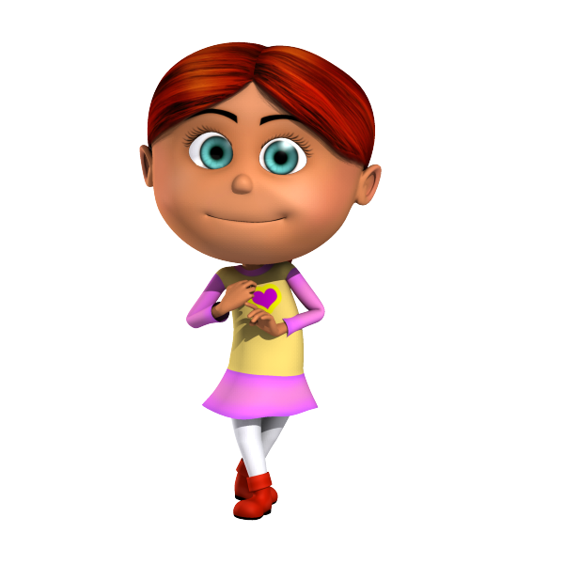
What if I need extra help?
Listen to…
Rhianna’s Story

Slide 11
Good luck from all of us…..

