Slide 1
Bexley Voice SEND Mental Health Focus Day
Understanding the range of mental health support for your child in Bexley

Slide 2
Overview of session
1. Public Health whole school and within school approaches
2. Kooth
3. Mental Health Support Teams in schools
4. Early Intervention and Specialist Advice Service
5. Child and Adolescent Mental Health Team
6. Bexley Community Learning Disability Team

Slide 3
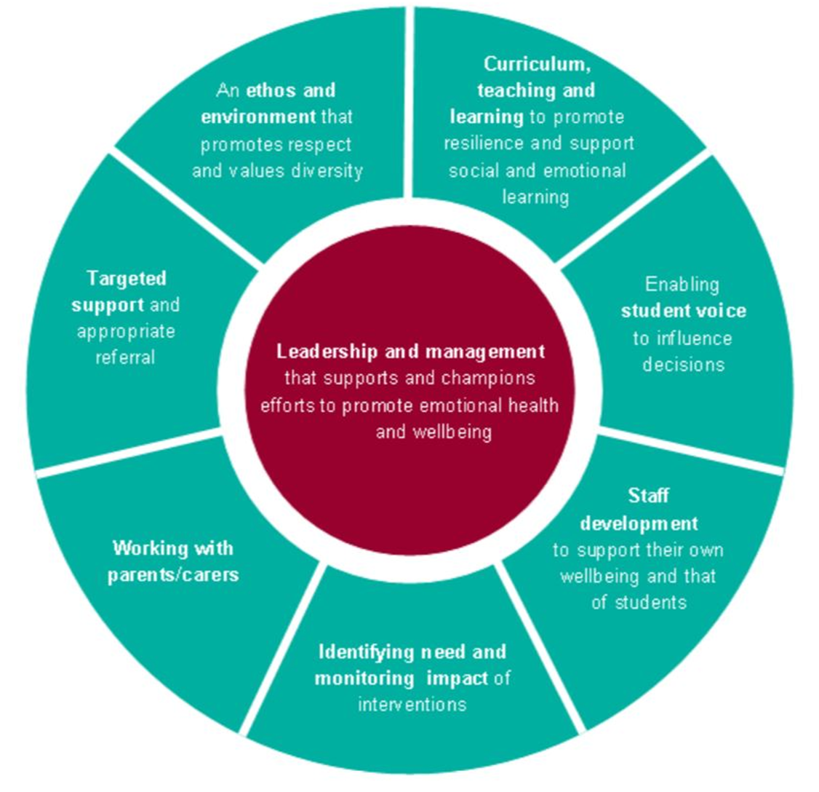
Whole school approach to mental health and wellbeing
Notes:
Curriculum teaching - Teaching about mental health during PSHE
lessons and assemblies
Enabling student voice to influence decision In primary and secondary schools children & young people are trained to become wellbeing champions/ambassadors to drive the wellbeing agenda and lead on specific campaigns
Staff development - Workshops2 day course; ad hoc training
Working with parents and carers Achieved through the delivery of workshops on Parents/carers own wellbeing Children and young people’s emotional health
and wellbeing Giving parents strategies to support their children

Slide 4
Bexley Public Health Advisor for Children and Young People
Pascale Berthellet
supporting the whole school community to promote positive mental health & build resilience
Curriculum teaching - Teaching about mental health during PSHE
lessons and assemblies
Enabling student voice to influence decision In primary and secondary schools children & young people are trained to become wellbeing champions/ambassadors to drive the wellbeing agenda and lead on specific campaigns
Staff development – Workshops; 2 day course; ad hoc training
Working with parents and carers Achieved through the delivery of workshops on Parents/carers own wellbeing Children and young people’s emotional health and wellbeing. Giving parents strategies to support their children

Slide 5
Mental Health Support Teams in Schools - Bexley
Bexley Voice SEND Mental Health Focus Day
12th October 2021

Slide 6
Bexley CAMHS
Overview of teams/structure locally
Bexley CAMHS
Adolescent Team
Generic Team
Learning Disabilities & Neurodevelopmental Team (LDND)
Children who are looked after (CLA) /Under 5s Team
Mental Health Support Teams (MHST)
Community Health & Wellbeing Service (CHEWS)

Slide 7
Key Principles of MHST
Involving young people, schools and families in shaping the support they receive
Improving the links between education and mental health services and working in partnership
Enabling equal access for all young people
Supporting young people and families at times of transition
Evaluating effectiveness to inform practice and future development
Supporting a whole school approach to Mental Health and Wellbeing

Slide 8
Bexley MHST team structure
Jenny Eldred
Team Manager
Jayne Maynard
Team Admin
Emily Coribel
Supervising Practitioner
Bonnie Chandler
Supervising Practitioner
Michael Buckland
Senior Practitioner
Ellie Robertson
Senior Practitioner
Toyin Israel
Senior Practitioner
Rachel Siddall
Senior Practitioner
Educational Mental Health Practitioners (EMHP)
Katie Debonis
Jade West
Carine Samba
VACANT
Bengi Biskin
Comfort Anwuzia
Vertrice Baillie
Anusha Pau

Slide 9
Role of the MHSTs
Three core roles of MHST
1. Delivering evidence based interventions for those with mild to moderate mental health issues.
2. Supporting the senior mental health lead/s in each education setting to introduce or develop a whole school or college approach to mental health and wellbeing.
3. Giving timely advice to school and college staff, and liaising with external specialist services, to help children and young people get the right support and stay in education.

Slide 10
Delivering evidence based interventions for those with mild to moderate mental health issues.
The new teams will carry out interventions alongside established provision such as the early intervention in schools team, counselling, educational psychologists, and school nurses building on the menu of support already available and not replacing it. The MHST will provide:
Individual face to face work: e.g. effective brief, guided self-help interventions for children, young people and families experiencing anxiety, low mood, behavioural difficulties.
Group work for pupils or parents: e.g. CBT informed groups for young people presenting with anxiety, low mood, low self esteem.
Group parenting classes: e.g. groups with a focus on behaviour and communication difficulties

Slide 11
Remit of support from MHST
Health Need | Offer
Anxiety (child up to 11 y/o) | Guided self help via parents/carers
Anxiety (adolescent) | Guided self help
Low mood (adolescent) | Guided self help
Challenging behaviour (child 4-8 y/o) | Guided self help via parents/carers
Stress (due to common adverse experiences (bullying/social pressures/transitions/exams)) | Health promotion via individual and groups
Developing resilience and wellbeing | Health promotion via groups, parents/carers and peer monitoring

Slide 12
Supporting the senior mental health lead in each education setting to introduce or develop a whole school or college approach to mental health and wellbeing.
The teams will support the senior mental health lead in each school to introduce or develop their whole school approach by:
Working with the senior mental health lead and existing service providers, to map what provision is already in place in settings and where the gaps are.
Providing targeted help as agreed with the lead, e.g. to support monitoring of well being across the schools and colleges, teaching about mental health (in the context of health education becoming compulsory from September 2020)
Sharing understanding how peer support and interpersonal relationships impact on children and young people’s wellbeing and mental health.
Delivering training on how to help children and young people, parents/carers and teachers to identify and manage stress and anxiety.

Slide 13
8 Guiding Principles of Whole School Approach

Slide 14
Giving timely advice to school and college staff, and liaising with external specialist services, to help children and young people get the right support and stay in education
The MHST Team will provide responsive directly accessible advice which promotes good mental health and well-being. We will support the school community by active and timely signposting to other services including to specialist clinic based CAMHS.
To join up and simplify processes for children and families
Learning from children and young people most at risk of health and educational inequalities and changing how we think and what we do because of this on-going learning
To help education and mental health professionals to plan together more easily so that children get the support they need when they need it
Early signs of change include school specific referral protocols, increase in quality and consistency of referrals, frequent and effective communication between health and education colleagues
Being a consistent presence and link into schools and an effective link out of schools to other sources of support and treatment for children, young people and families

Slide 15
Levels of need & support
Prevention and Advice
Thriving, good mental health
Getting more support
Regular or frequent impact on well-being and mental health
Getting Support
Early signs of impact on well-being and development
Mild > Moderate > Severe
Public Health/ MHST Intervention
EIT advice/input
CAMHS specialist support

Slide 16
The MHST Pilot runs for 2 years
Year 1: Jan 2021- Jan 2022
Year 2: Jan 2022 – Jan 2023
Jan 2021
Start of the 2 year MHST pilot
Jan 2022
EMHPs and Supervising practitioners complete university course
21st Jan 2021
MHST Launch to phase 1 schools
March 2021
Go live of full MHSTs in all Schools involved in MHST phase 1
Nov 2021
Induction of MHST to phase 2 schools
25th Jan 2021
EMHP course starts
Supervisor course starts
Jan 2022
MHST becomes operational in remaining 12 schools
Jun 2020
Bid successful for two MHST teams within Bexley Schools
Jul – Sep 2020
Participating schools identified
Oct-Dec 2020
Recruitment of staff to team
OCT 2021
Local evaluation with Phase 1 schools
Jan 2023
End of the MHST programme
National evaluation undertaken
Term 1 – EMHPS in university 3 days
Term 2 – EMHPS in university 2 days
Term 3 – EMHPS in university 1 day

Slide 17
Phase 1 Schools – Jan 2021 | Phase 2 Schools– Jan 2022
Belvedere Infant | Willow Bank Primary
Belvedere Junior | Peareswood Primary
St Paul’s (Slade Green) CoE Primary | Lessness Heath Primary
St Augustine of Canterbury CoE Primary | Bedonwell Junior
Christ Church (Erith) CoE Primary | Northumberland Heath Primary
St Fidelis Catholic Primary | Pelham Primary School
Trinity Church of England | St Joseph’s Catholic Primary
Harris Garrard Academy | St Thomas More Catholic Primary
 | Barrington Primary
 | Haberdashers’ Aske’s Slade Green Temple Grove
 | Welling
 | Bexleyheath Academy

Slide 18
Contacts
Name / Organisation | Role | Email
Shamara Bailey Oxleas NHS Trust | Bexley CAMHS Interim Operational Manager | shamara.bailey@nhs.net
Jenny Eldred Oxleas NHS Trust | Bexley CAMHS MHST Team Manager | jenny.eldred@nhs.net
Nidhi Dholakia Wellens Oxleas NHS Trust | Bexley CAMHS CHEWS Clinical Lead | nidhi.dholakia-wellens@nhs.net
John Miller London Borough of Bexley | Head of EIT, Specialist Teacher Service and Principal Educational Psychologist | John.Miller@bexley.gov.uk
Ursula Millwood London Borough of Bexley | Senior Educational Psychologist | Ursula.Millwood@bexley.gov.uk
Pascale Berthellet London Borough of Bexley | Public Health Advisor for Children and Young People | Pascale.Berthellet@bexley.gov.uk
Jessany Wooding SEL CCG Bexley | CYP Commissioning Manager | j.wooding@nhs.net
Mary Dos Santos Justo SEL CCG Bexley | Interim AD Integrated Commissioning CYP | mary.dossantos-justo@nhs.net

Slide 19
Early Intervention and Specialist Advice Service
John Miller Head of Early Intervention and Specialist Advice Service (EISAS) and Principal Educational Psychologist

Slide 20
EIT Early Intervention Team.
Educational Psychologists *
Social, Emotional and Mental Health (SEMH) Support Partners*
Early Intervention Social Worker *
AEN/SEN Support Partner
SEN Strategic Support Partner
(*= schools buy these teams in )

Slide 21
Specialist Advice Teams
The service consists of staff supporting the following areas:
Autism Advisory Team
Bexley Early Autism Service (BEAS)
Hearing Impairment (HI)
Visual Impairment (VI)
Speech and Language
Portage home visiting

Slide 22
Wellbeing work that EPs do:
Work with children to assess their levels of anger, self esteem, anxiety, low mood and resiliency.
Finding out from children what they think.
Observations in school.
Advice to school and parents and reviews of progress.
resiliency programmes with pupils and training staff.
Therapeutic Play - training and supervision of teaching assistants
Video Interactive Guidance
Therapeutic interventions
training to schools re pupil and staff strategies

Slide 23
Semh support partners
Mild, moderate and sometimes severe needs
Individual work with pupils, parents over time
Behaviour management advice to teacher and TAs and parents.
Social skills groups
Training school staff on social, emotional or mental health skills
Time bought in by schools so not all schools have SEMH partner input

Slide 24
Early Intervention Social Worker
Focus on family issues but not at Child in Need level or higher.
Direct work with parents
Liaising between parents and schools
Time purchased by schools, so not in every school

Slide 25
ASD Advisory Teams – wellbeing activities
School aged advisory team:
121 work with asd pupils re understanding diagnosis, preventing placement breakdown, reducing risk of exclusions.
Primary secondary transition support – 121s for all pupils where concerns re transition, attending transition planning meetings, 121s overtime to help child develop coping skills
Parenting programmes – Living with Autism, Teen Life.
Bexley Early Years Autism Service:
Supporting preschool children prior to transferring into Reception class.
Notes:
1. How to encourage school to prioritise mental health, including as part of an EHCP
Look for Personal Social Health Education/Social Moral Spiritual Cuulture policies.
Talk about wellbeing issues in annual review. Ask for this to be included in child’s Plan. if already in plan ask school how they are implanting what Plan says.
2. Why can’t I get the support I need for my child? Why am I not listened to and made out like this is all in my head? – video situations on phone, home school book, ask school how best to communicate, list concerns and talk through list in a meeting. talk to GP if just home issue.
3. How do you reassure your child that school is compulsory? My daughter struggles to understand that it’s not optional? How can a schools help children explain why school is important? Work with teacher to make school fun so child wants to go to school. sometimes just have to do things – good lesson for adult life. Identify things child enjoys on a timetable

