Slide 1
Anxiety in young people (with additional needs)
Dr Kate Doherty and Dr Nidhi Dholakia-Wellens
Clinical Psychologists in Bexley CAMHS
(With thanks to Drs Anna Moriarty, Alex Oxley and Lisa Dunnigan for some of the slides)
11th March 2020

Slide 2
What we will cover today
What is anxiety and why do we have it
Anxiety and children/young people
Ways of understanding anxiety
Anxiety and ASD/ADHD
Management / Intervention
CAMHS referrals
Questions and discussion

Slide 3
What is anxiety?
Anxiety refers to feeling nervous, worried and afraid in situations which are demanding

Slide 4
What is anxiety?
It is an evolutionary adapted mechanism to protect us in dangerous situations and triggers the body into fight/flight response

Slide 5
What is anxiety?
Anxiety becomes problematic when we start reacting to stimuli that are not actually dangerous
Particularly when this impacts on our daily lives….

Slide 6
Anxiety in children
Worries and fears are a natural and adaptive part of childhood development.
Toddlers
  Fears of imaginary creatures
  Fears of darkness
  Normative separation anxiety
School-age Children
  Worries about injury and natural events (e.g. storms, death of a loved one)
  Worries about a new class, school test, friendships
  ALL AGES – anxiety in response to uncertainty, distress or significant change at home e.g. parental separation, moving house

Slide 7
Anxiety Disorders
Anxiety disorders:
most common childhood-onset psychiatric disorders (9% - 32% prevalence rates)
diagnosed when concerns are persistent and excessive, causing significant distress or impairment in day-to-day life
Anxiety disorders in children are associated with
-educational underachievement and
-co-morbid mental health problems
-functional impairments that can extend into adulthood

Slide 8
Different types of anxiety
Anxiety disorders
Generalised anxiety disorder
Social anxiety disorder
Panic disorder
Agoraphobia
Specific phobias
Separation anxiety
Selective mutism
Obsessive-compulsive and related disorders
obsessive-compulsive disorder, post-traumatic stress disorder and acute stress disorder

Slide 9
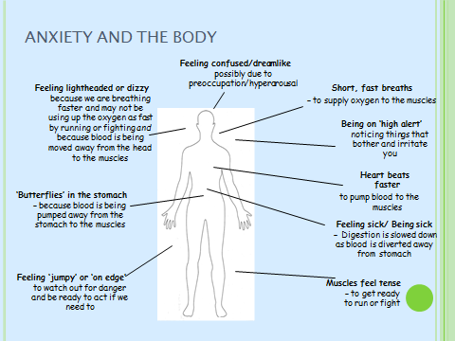
Physical symptoms of anxiety

Slide 10
Impact of significant anxiety
Feeling tense / fidgety
Difficulties concentrating and processing information
Poor sleep
Changes in eating
Rumination – negative thoughts
Anger / irritability / oppositional behaviour
Physical symptoms
Clinging to care-giver
Avoidance/disengagement/withdrawal
School refusal
Relationship difficulties
Social isolation

Slide 11
Living with anxiety
YoungMinds – Living with anxiety clip
https://www.youtube.com/watch?v=mprhqMRz5PU

Slide 12
Cognitive Behavioural model of anxiety

Slide 13
Anxiety – how it affects us
Physical: heart racing, sweating, muscle weakness, hyperarousal, hyperactivity, pains (stomach), nausea, inability to concentrate, sleep problems,
Thoughts: ‘all-or-nothing’, assume the worst, dwell on the worrying thought
Feelings: fear, irritability (anger, frustration)
Behaviours: physical/verbal aggression, repetitive behaviours, withdrawal & avoidance, swearing, biting, destroying things, humming, rocking, shouting
Coping strategies:
Avoidance of anxiety provoking situations – reduces opportunities for learning and increases anxiety
Need for sameness/rituals and routine – repetitive stereotyped activities e.g. repetitive questioning

Slide 14
Anxious Thinking Styles (taken from ‘Think Good, Feel Good’ by Paul Stallard)
NEGATIVE GLASSES – Only let you see the negative things
POSITIVE DOESN’T COUNT – Rubbishing the good things that happen
BLOWING THINGS UP – Negative things become bigger than they really are
MIND READERS and FORTUNE TELLERS – Expect things to go wrong
Look at these thoughts and see if you can find the thinking error.
‘People are always unkind to me.’
Luke went on a school trip to a great theme park. When asked if he had a good day Luke said, ‘No, I didn’t like my sandwiches.’
‘My friends will think I look really stupid in these trainers.’
Amy played her flute brilliantly in the school concert. When her teacher said how well she had done Amy thought, ‘That was just lucky, I don’t usually play that well.’

Slide 15
Vicious cycle of anxiety
Talking to a group of peers
Heart racing, sweating, butterflies in the stomach
I never say the right thing! I bet people are laughing at me!
Avoid talking to new people
Fewer opportunities to practice skills

Slide 16
Safety behaviours
Safety behaviours are used to protect against anxiety states in situations where anxiety cannot be prevented
They reinforce and maintain anxiety
Examples:
Asking for reassurance
Being over-prepared
Rituals
Anxious responses from others (parents) feed anxiety

Slide 17
Anxiety in ASD
Anxiety is high in people with ASD due to their struggle to understand the ‘neuro typical’ world
Social difficulties (leading to decreased self-esteem), communication difficulties and problems finding flexible responses to may also lead to anxiety.
Prevalence rates 40% of CYP with ASD (van Steensel et al., 2011)
Anxiety leads to frustration, leading to anger
Many people on the autism spectrum may have difficulty describing the symptoms they experience.

Slide 18
Why do children with ASD struggle to regulate emotions?
Difficulties understanding and predicting other people’s thoughts and behaviours.
Difficulties reading others’ body language
Problems with social learning
Difficulties with planning; problem solving; strategy formation
Difficulties in seeing an overview of a situation
More likely to experience negative situations

Slide 19
Triggers for anxiety in ASD
Change in routine
Preference for sameness
Environment / Sensory experience
Unstructured time
Social situations
Situations which require processing of feelings
Peer rejection
Demands from teacher/care-giver
Difficulties asking for help
Combination of these factors

Slide 20
Communication difficulties & anxiety
Teacher
gives instructions
Young person’s response
Teacher interprets reaction as defiant
Teacher raises voice
Anxiety

Slide 21
How often do you hear….
‘Angry, aggressive, violent child’???

Slide 22
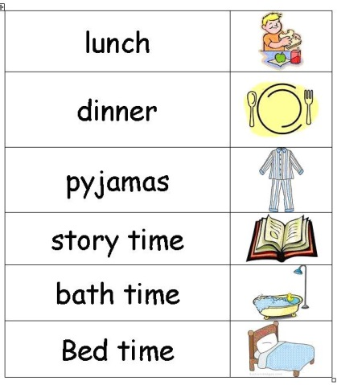
Helping anxiety in children with ASD
Make sure you prepare for any change in routine
Think about how you can adapt the environment
Use visual supports and timetables
Try social stories or comic strip conversations to develop social understanding

Slide 23
Management of anxiety in ASD and ADHD
Shared understanding of anxiety triggers – preventing and intervening early (school, care-giver & young person)
Addressing other factors e.g. bullying, parental mental health, social skills training
Psycho-education
- understanding anxiety and role of safety behaviours (parent & child)
  - Scaling emotions, identifying real dangers vs. false alarms
Understanding ADHD/ASD diagnosis (accessing support services)
Try not to take things personally when your child comes home from school is rude or offensive. S/he may be letting off steam after a stressful day. A child with ADHD/ASD may need quiet time before you start asking about school.
Evidence-based interventions for anxiety
For overview Creswell C, Waite P, Cooper PJ (2014). Assessment and management of anxiety disorders in children and adolescents. Archives of Disease in Childhood: 10.1136/archdischild-2013-303768

Slide 24
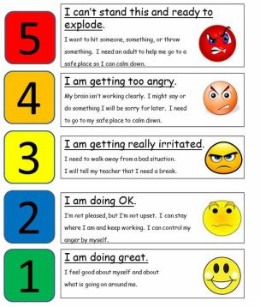
‘Incredible 5 point scale’
If your child is verbal it may provide them with phrases to appropriately communicate their thoughts and feelings.
This can also help to remind your child of their strategies used to calm down when they are feeling anxious.

Slide 25
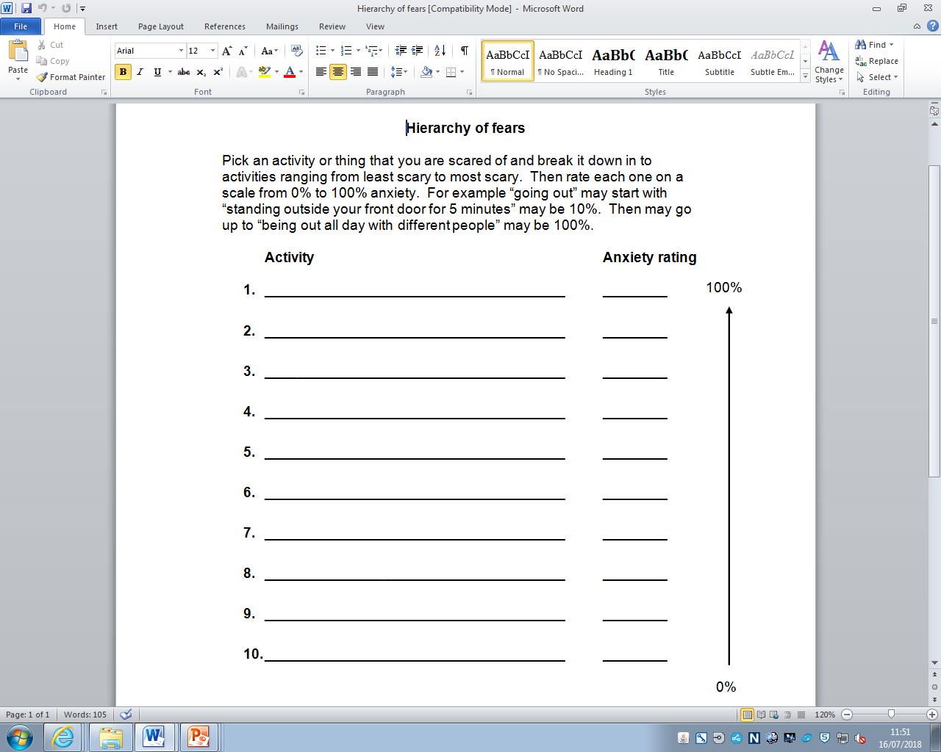

Tackling avoidance
M M
&
Mind Mood
Help your young person select what they’re going to try and how
Going to a party
Going to a sleep over
Having a friend around

Slide 26

Breaking down goals into baby steps
Goal: go into school and stay in lessons
  Step 1: Go to the school gate with Mum/Dad
  Step 2: Go into the reception for 5 minutes
  Step 3: Go in for part of break / lunch
  Step 4: Go into easiest lesson with a time out card to leave if needed
  Step 5: Go into easiest lesson and stay for full lesson
  Step 6: Go from easiest lesson into start of next lesson
  Step 7: Go into more difficult lesson with a time out card
  Step 8: Go into easier day and staying in
  Step 9: Go into a more difficult day and stay in
  Step 10: Go into school and stay in lessons

Slide 27
Relaxation

Slide 28
Responding to your Child’s Anxiety
  Support child in staying calm, e.g. doing relaxation exercises/mindfulness together
  Lead by example - Show them how to cope well with anxiety in how you do it
  Challenge your own worries about your child and how they will manage
  Manage your own anxiety and worries
  Seek support
Notes:
Kate

Slide 29
Young people’s thoughts on how parents can help
For family to know to try and understand more about anxiety and her because they get frustrated.
For parents to try and stay calm. (in stressful situations)
Not to be forced to do things when I don't want to and to try and understand.

Slide 30
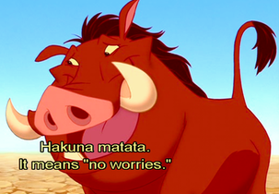
What you communicate to your child about anxiety
  Children will often look to adults for confirmation of their worries
  Show them that you are calm and confident
  Demonstrate that you believe it is nothing more dangerous than anxiety
  Communicate that you know that they are safe and that they will be fine
  Help them chill out and think it through
Notes:
Kate

Slide 31
Remember to look after yourself
Take care of yourself: Anxiety in one child can cause stress or anxiety in other family members. Try to stay healthy and positive yourself and don't ignore your own needs. Stress can affect your own mood/emotions, so it will be important to make time for things you enjoy and look after yourself too.
Support: It can be overwhelming being a parent of an anxious child/teenager with ADHD or autism. If you feel comfortable, talk to friends, join a support group, or perhaps see your GP about possible help of your own. It’s important to talk about how your child's difficulties are affecting you, rather than bottling up your emotions or you may become depressed too.
Notes:
Bonnie

Slide 32
Remember to look after yourself (2)
Managing difficult feelings: Relaxation, self-nurturing or Mindfulness
Avoid blame: Try not to blame yourself for your child's anxiety as it is unhelpful and can make things more stressful. You may find it reassuring to remember that in most cases the cause of difficulties are linked to a number of factors, so it's unlikely any one person is "responsible“.
Set achievable goals: Motivation & energy levels decrease when emotional difficulties are present. Set small but achievable goals during low periods to boost a sense of accomplishment and act as encouragement

Slide 33
Recommended interventions - Psychosocial interventions
Interventions to expand the child or young person's communication, interactive play and social routines.
Interventions to increase parent/carers', teachers' or peers' understanding of, sensitivity and responsiveness to, the child or young person's patterns of communication and interaction

Slide 34
Self-help resources
Moodjuice self-help packs (e.g. for anxiety, panic, sleep problems) available on the internet
‘Overcoming Your Child's Fears and Worries – A self-help guide using cognitive-behavioural techniques’ – Cathy Creswell & Lucy Willetts
YoungMinds website (young people’s mental health)
National Autistic Society (NAS) website
http://headscapebexley.co.uk – Bexley CAMHS website with tips/advice etc.

Slide 35
Evidence based intervention - Cognitive Behavioural Therapy
For children who have verbal & cognitive ability to engage
Helping child to understand links between situation, thoughts, feelings and behaviours
Reduce safety behaviours and avoidance
Recognise anxious thinking and learn ways to challenge

Slide 36
Adaptions to CBT
emotion-recognition training
more use of written, visual information and structured worksheets
a more concrete and structured approach
simplified activities, e.g., multiple-choice worksheets
involving a parent/carer to support intervention/ home tasks
maintaining attention by offering regular breaks
use young person's special interests in therapy

Slide 37
Referral to CAMHS….
Bexley Child & Adolescent Mental Health Service
How to contact us:
Main Reception Telephone number: 020 3260 5200
Fax: 020 3260 5273
Email: oxl-tr.BexleyCAMHSReferrals@nhs.net
Bexley CAMHS provides specialist mental health assessment and treatment services for:
Children and young people with significant, complex or enduring emotional or mental health difficulties (i.e. in addition to ADHD/ASD)
From birth to 18 years
Intervention for families/carers
We provide high quality, evidence based interventions to children, young people which are adapted to individual needs

Slide 38
Referral to CAMHS cont…
Who can refer to CAMHS?
ANY professional working with the child/young person OR
Self-referrals through Bexley CAMHS Headscape website
Who can be referred?
Children and young people from birth to 18 years who meet the clinical eligibility criteria and have a Bexley GP
Young people who are close to their 18th birthday (aged 17 years 9 months and over) should be referred to adult mental health services in the interests of continuity of care

Slide 39
In a crisis…
Bexley CAMHS 0203 260 5200
Opening hours: Mon - Fri (9am-5pm) - Ask to speak to duty clinician
Weekends, evenings & bank holidays, emergency support is available from:
Oxleas NHS Crisis Line – 0800 330 8590
South London Partnership NHS CAMHS Crisis Line (5-9.30pm): 0203 228 5980
Queen Elizabeth Hospital – 0208 836 6000
Child Line – 0800 11111
Samaritans – 08457 909090
Call emergency services (999) or go to nearest A&E
Call the police if necessary (999)

Slide 40

Discussion – Learning from each other
Talk in 3s about some of the key difficulties you are facing responding to your child’s anxiety
Come up with your 3 best tips that you find helpful when supporting your child
Notes:
Bonnie

Slide 41

Questions/Discussion

