Slide 1
ADHD and Anxiety
Dr Sonia Bailey, Bexley Educational Psychology Service

Slide 2
Agenda
Reasons why CYP with ADHD experience anxiety
Ways in which anxiety can be communicated
Methods of addressing anxiety in CYP with ADHD

Slide 3
Recap – ADHD Criteria
DSM – 5 (2013)
A persistent pattern of inattention and/or hyperactivity-impulsivity that interferes with functioning or development, as characterised by at least 6 out of 9 inattention symptoms and /or at least 6 out of 9 hyperactivity and impulsivity symptoms (CYP)
Several inattentive or hyperactive-impulsive symptoms were present prior to age 12 years.
Several inattentive or hyperactive-impulsive symptoms are present in two or more settings (e.g. home and school).
There is clear evidence that the symptoms interfere with, or reduce, the quality of social, academic, or every day functioning. (Also, in NICE guidelines 2018)
The symptoms…. are not better explained by another mental disorder (e.g. mood disorder, anxiety disorder).

Slide 4
Recognising ADHD in Learning Environments

Slide 5
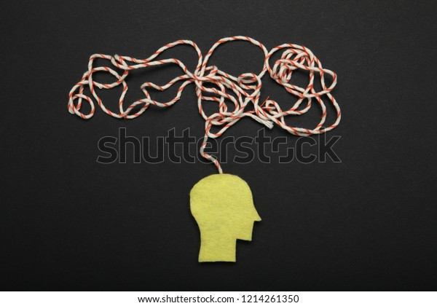
DSM-V Symptoms of Inattention
• Has decreased attention to detail, makes careless mistakes
• Has difficulty sustaining attention in tasks
• Does not seem to listen when spoken to directly
• Does not follow through on instructions
• Has difficulty organising tasks and activities
• Avoids tasks that require sustained mental effort
• Loses things
• Is easily distracted by extraneous stimuli
• Forgetful in daily activities
*Nine inattentive symptoms

Slide 6
DSM-V Symptoms of Impulsive/Hyperactivity
• Fidgets with hands/feet, squirms in seat
• Leaves seat when remaining seated is expected
• Runs about or climbs excessively; restlessness
• Unable to engage in leisure activities quietly
• On the go, as if driven by a motor
• Talks excessively
• Blurts out answers before question has been completed
• Difficulty awaiting turn
• Often interrupts or intrudes on others
*Nine hyperactive/impulsive symptoms

Slide 7
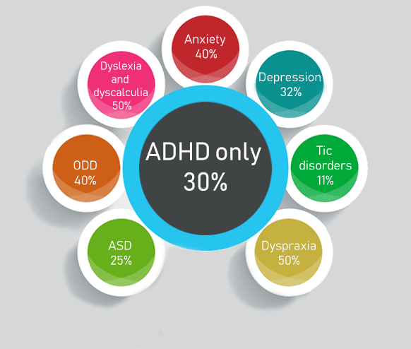

Slide 8
What is Anxiety?
Anxiety is a normal emotion. It’s the brain’s way of reacting to stress and alerting individuals to potential danger ahead.
It’s normal to feel anxious, worried or fearful in certain situations.
These feelings are our bodies natural ‘fight or flight response’ to a perceived dangerous or risky situation.
However if continuous feelings of anxiety impact ability to carry out life as normal, excessive anxiety can make individuals avoid school, family get-togethers, and other social situations that might trigger or worsen their symptoms.

Slide 9
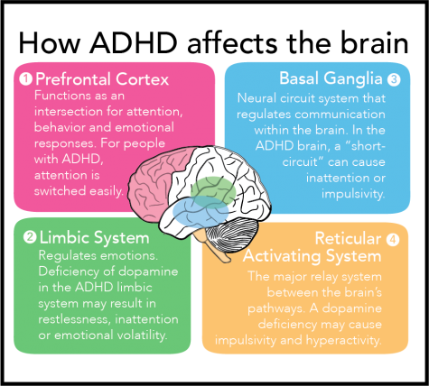
ADHD and the Brain
https://www.youtube.com/watch?v=Rfcdx3qm77M

Slide 10
Traumatic Stress and the Brain
Toxic levels of stress hormones rewire brain connections and over time can cause neuronal cell death, especially in the prefrontal cortex and limbic systems

Slide 11
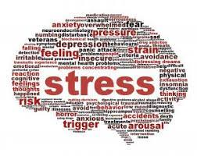
Reasons why CYP with ADHD struggle with anxiety
Higher stress levels
Low self-esteem
Difficulty following daily routines
Difficulty completing tasks
Emotional dysregulation
Task: Think about what a worry feels like

Slide 12
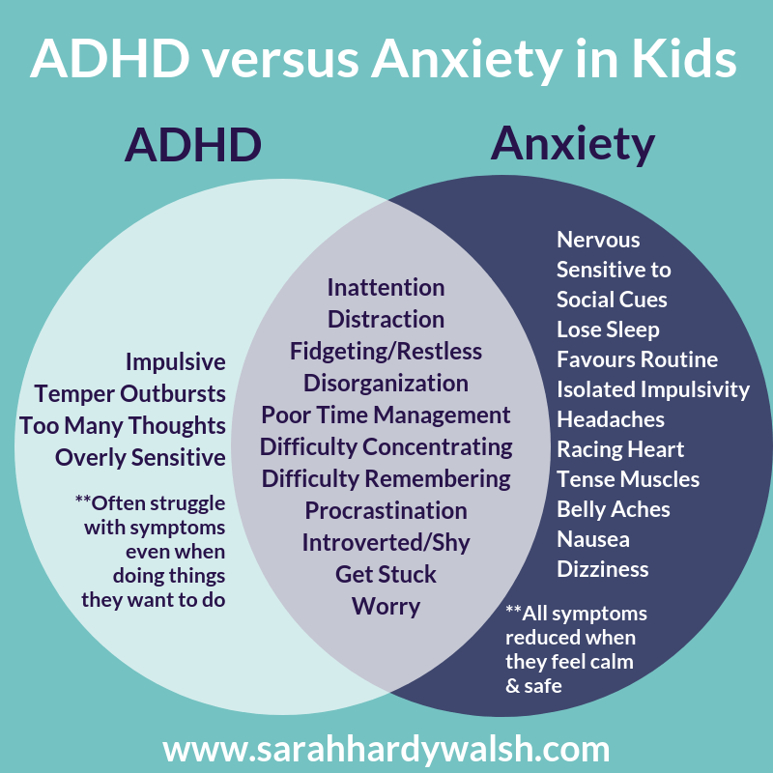

Slide 13
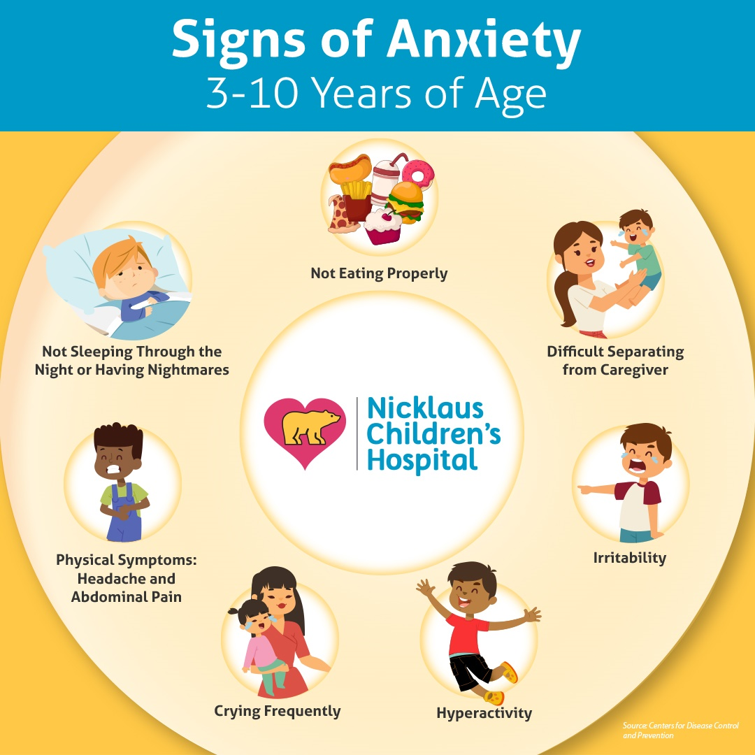

Slide 14
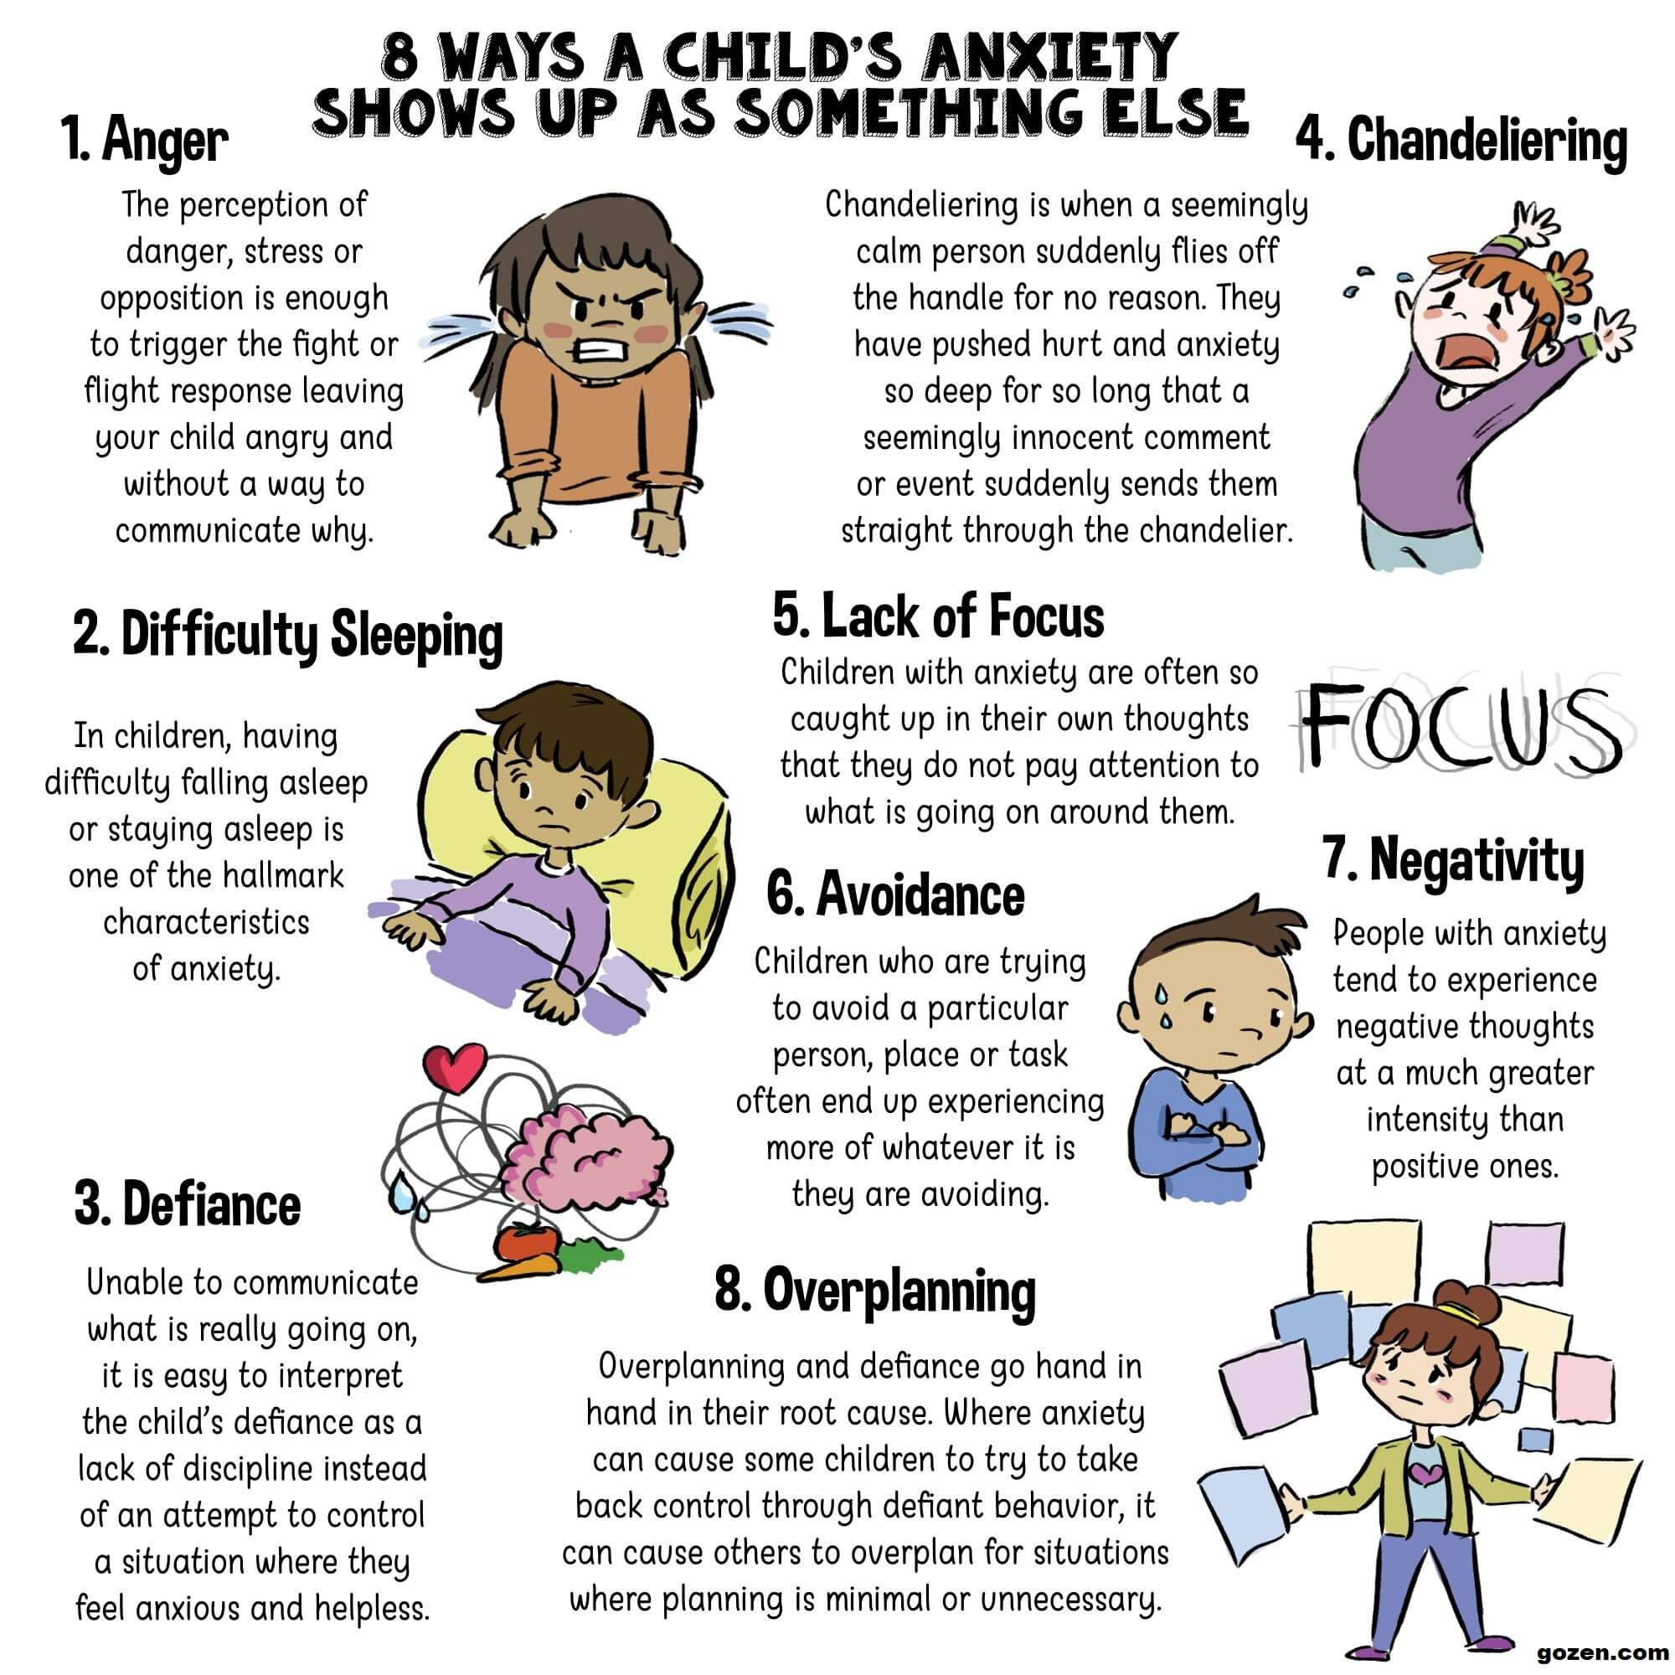
Further symptoms of anxiety in children with ADHD:
Withdrawing from peers
School refusal
Being disruptive or clowning around in school
Hair twirling, skin picking, or other anxious behaviours

Slide 15
Anxiety

Slide 16

Adversity and Adult Support
When confronted with adversity:
Adrenaline releases fight or flight response
When stress response systems are activated in children in the context of supportive adult relationships, these physiological effects are buffered.

Slide 17
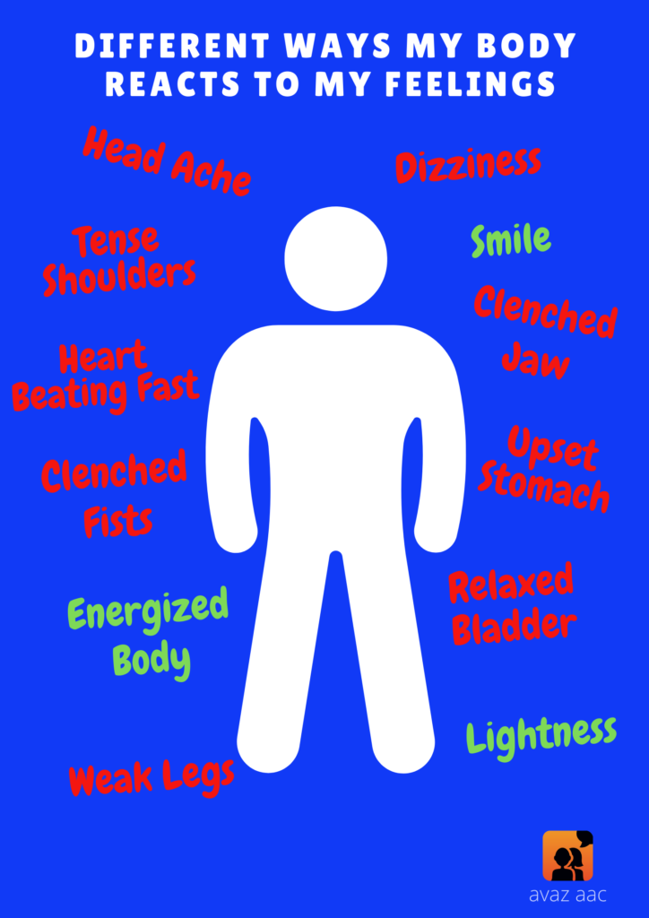

Slide 18
Environmental Modifications
Operate on your child’s time: Twice as much time, half as much done.
Avoid rushing
Monitor demands
Establish routine
Prepare for change to routine
Break tasks down into smaller steps
Provide ongoing feedback
Check in on a regular basis
Instead of saying… | Say or do this instead…
Do your homework. | Pick up 10 items of clothing from the floor.
Tidy up your bedroom. | Answer questions 1 and 2 from your maths book.

Slide 19
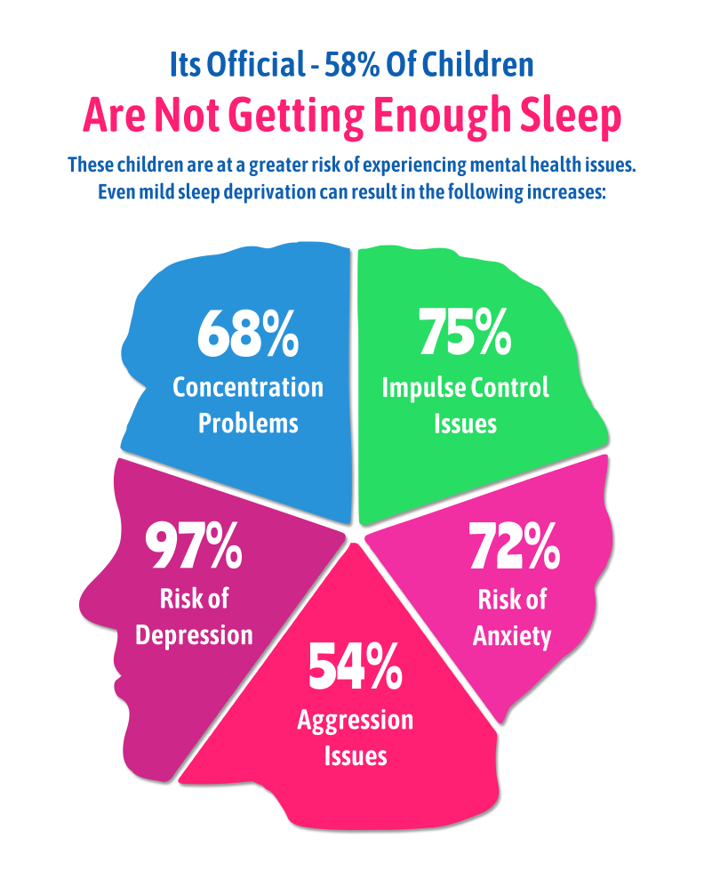
Anxiety and sleeplessness usually go together!
One feeds the other.
© Sue Jennings Hinton House Training

Slide 20
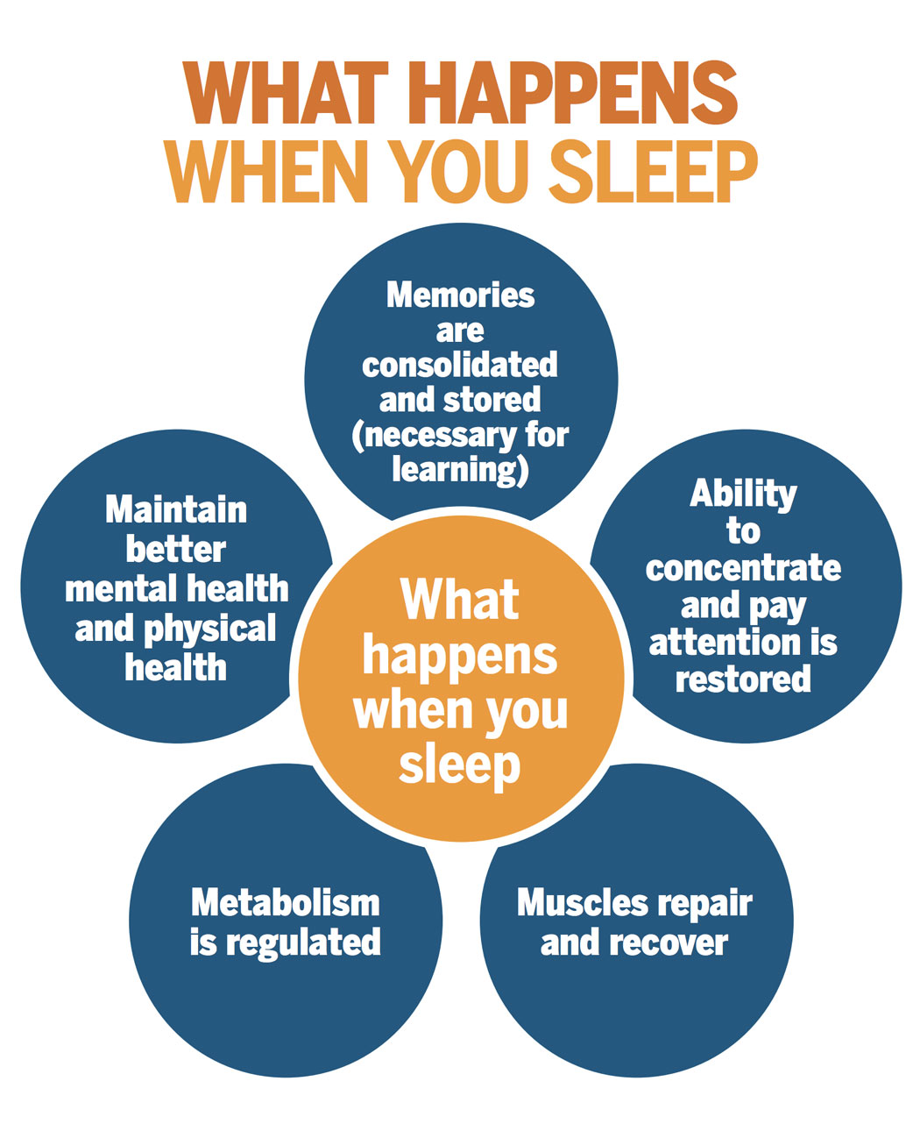

Slide 21
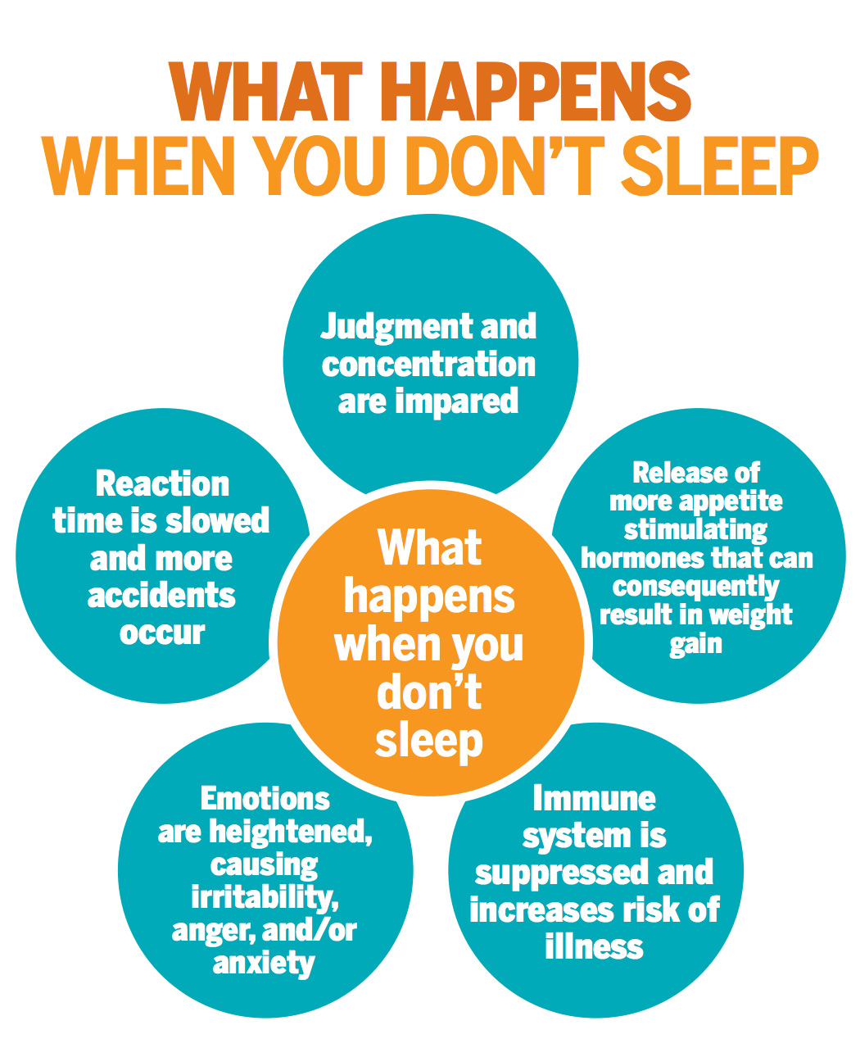
Often a poor sleep cycle – too little, too much, startled reaction during sleep.
Less sleep a night than their peers.
Good sleep is essential for emotional stability.

Slide 22
Visualisation
Think of a happy time or place when you were having fun. Try to remember all the very small things of that special memory:
What were you wearing?
How did the air smell?
What could you hear?
What did you see?
“Thinking of good memories makes us feel really good inside and if you practice, soon just thinking of happy times will make you actually feel that way.”

Slide 23
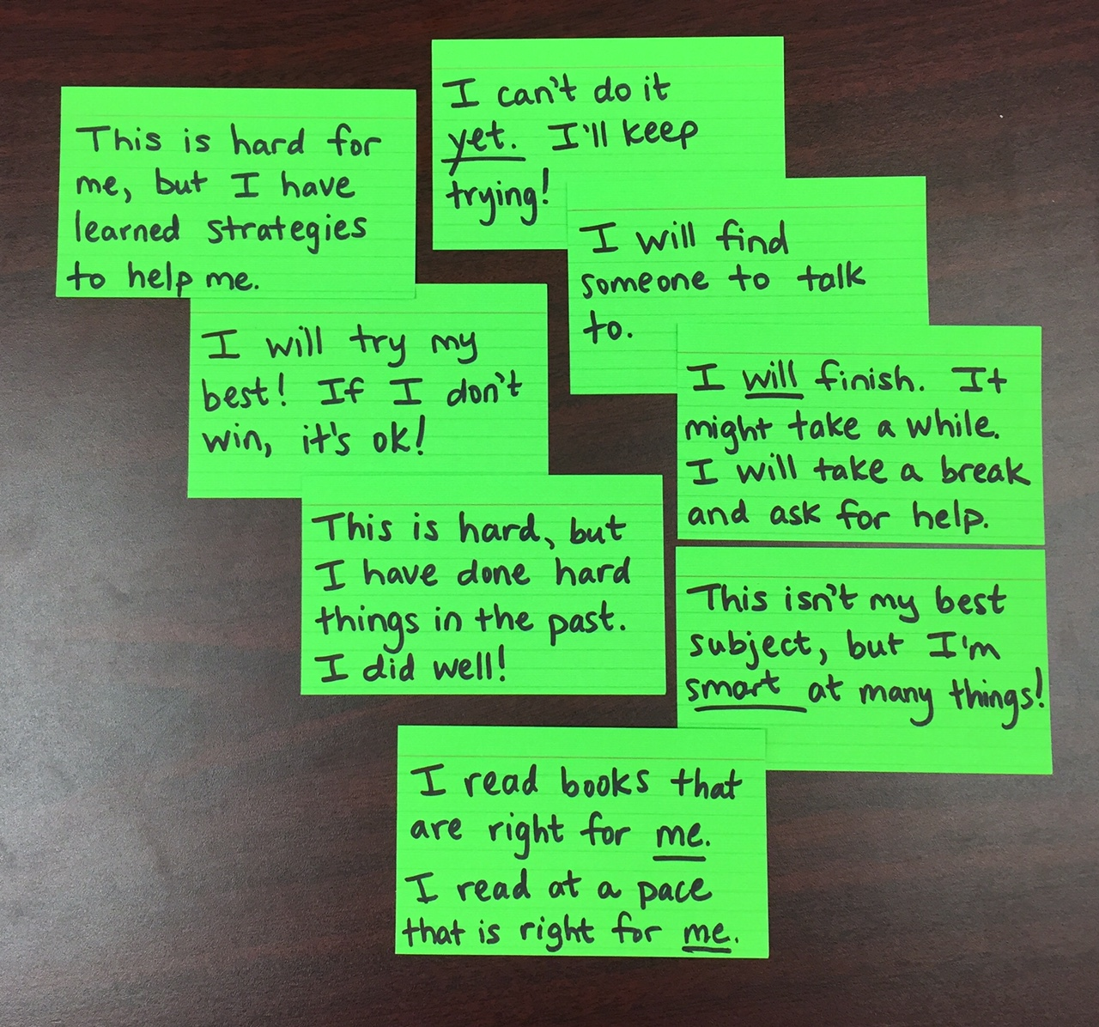
Positive Thoughts
Identify negative thoughts and change them into positive thoughts

Slide 24
Calm Thinking
What am I worried about?
Why does it worry me?
What are the chances it will happen?
What proof do I have that it will happen?
What else could happen?
So what if it happens?
Can I be absolutely sure it won’t happen?
How could I handle it if it happened?

Slide 25
Calming words 🍂
Breathe in while you say to yourself "I feel calm"
Breathe out while you say to yourself "I let go of stress"
Breathe in while you say to yourself "Feel calm"
Breathe out and say to yourself "Let go of stress"
Notes:
Prcise

Slide 26
Naming Anxiety
Labelling anxiety (or other feelings). Practice identifying feelings and facial expressions.
Take turns with your child, pointing to faces that look “Mad,” “Excited,” “Sad,” or “Worried,” and describing a time when each of you experienced such a feeling. This exercise reminds children that adults have different types of feelings, too, and that they learn to manage them.
Ask your child to draw a picture of what his/her bad feelings look like, and give a form to his/her anxiety. Having an image of the “monster” makes it easier to fight it off.
Resources - childtherapytoys.com

Slide 27
Chase away bad feelings
Relaxation, breathing techniques, and visual imagery can help kids fight off depression and anxiety. Practice these in the evenings (they’ll also help your child unwind before bedtime). Once he’s mastered a calming technique, he can use it to stop a bad feeling in its tracks.
Relax: Have your child lie down and focus on and relax one body part at a time -hands, arms, chest-until their entire body is calm and anxious feelings have been crowded out.
Visualise: Ask your child to think about happy times or a good feeling; e.g. “being licked by a his/her pet puppy.” If your child is fearful of a particular situation, such as a test, s/he should picture him/herself successfully completing the test.

Slide 28
Monitoring
Sports watches - really good to monitor heart rate; a good concrete way of detecting signs of agitation e.g. through a fit bit.
Looking at peaks on a graph. Good evidence to show (the school) that the child is more agitated throughout the day than their face, body language or speech indicates.
Anxiety and agitation could be suppressed so much at school, it is violently released at home.

Slide 29
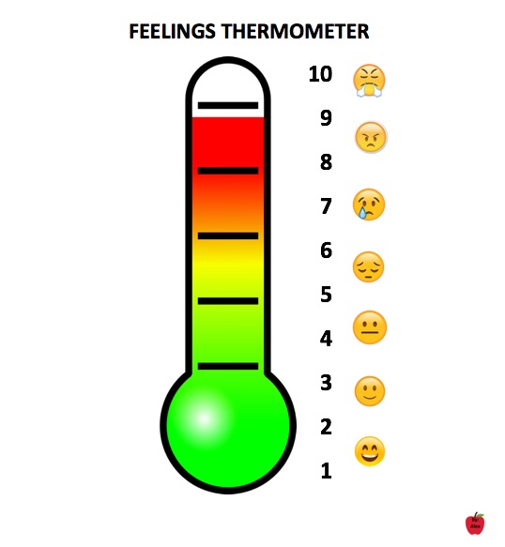
Feelings Thermometer
Identifies early cues and triggers.
Touch the point that represents the depth of yourr feeling (on the thermometer)
A thermometer helps with rating difficulties. If can’t say the word, ask them to tell you the number.
Appropriate voice e.g. count to 10 using a happy./sad/angry voice. Way to teach how to pick up emotion in self
or others.

Slide 30
Structure, emotions and cues
Ask how happy/sad/angry were you at different times of the day. The YP chooses the appropriate face to indicate on the timeline, and explain why.
The YP chooses which face to put at the specific time on the timeline and explains why: e.g. Which face do you choose at 10 am? etc

Slide 31
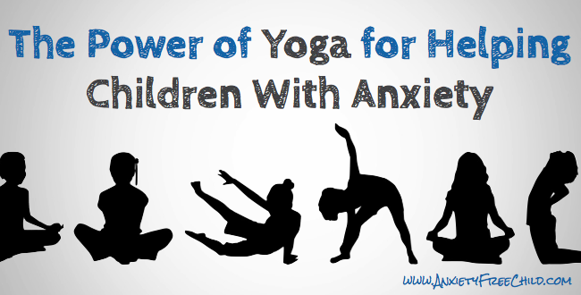
Awareness Tools - Yoga
Mindfulness, meditation, yoga, etc.
Yoga encourages individuals to be aware of their body.
Sometimes only 20 mins a day can help behaviour and concentration.
Anxietyfreechild.com

Slide 32
Physical Activity Tools for the Quick Release of Emotional Energy
Physical exercise as a regular part of their day. E.g. dancing in the bedroom to release tension; “running keeps anxiety away”. Leads to regular release of emotional energy.
Relaxation Tools
Drawing relaxes.
An effective tool is walking in nature – thoughts slow down

Slide 33
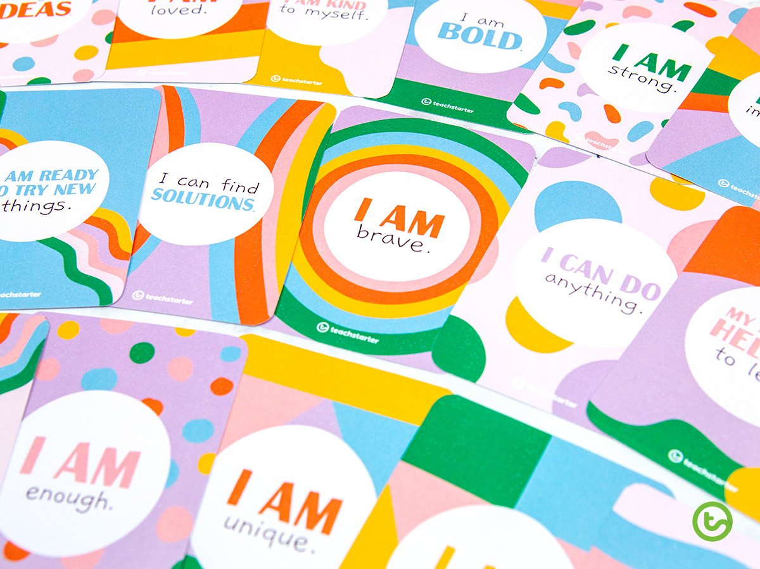
Vocalise how to manage emotions
Talk aloud what you’re thinking, to model what is desirable.
… Stay calm…, seek help, be flexible in thinking (‘Let’s try it another way’).
Thinking Tools
Create thought cards; e.g. I can be brave. etc
Place on their phone /noticeboard/ bedroom
Wall.

Slide 34

Turning Over a New Leaf
Write a word on each of three leaf pictures of something that makes you feel anxious; you can draw it if you prefer.
Turn the leaves over and write on the other sides, a way that you would like each one to change.
Choose one of the 3 as the most important
Draw a new leaf picture of how you can achieve it.
Create a leaf Mandala.

Slide 35


Slide 36
Relaxation and Deep Breathing
Relaxation:
Is a skill
Pick the right time
Make the time
Create a habit
Create a relaxing environment
Make it fun
Keep it simple and short.
When our children’s minds are tense, their bodies are tense, too. Relaxing their bodies will help them relax their mind.
Stop, Think, Breathe app

Slide 37
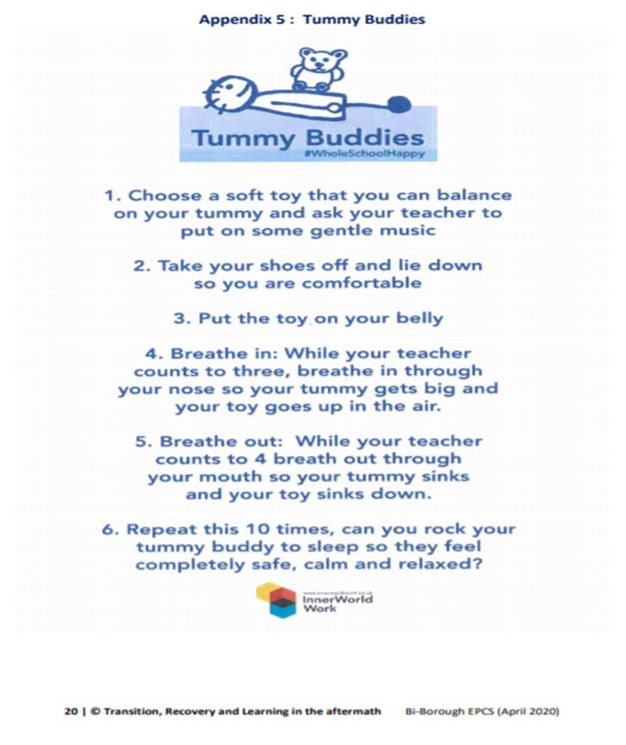
Tummy Buddies breathing exercise
Bi-Borough EPCS (April 2020) ‘Transition, Recovery and Learning in the Aftermath’

Slide 38
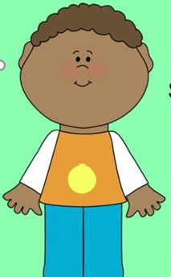
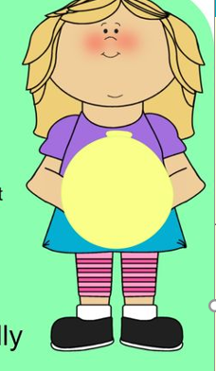
Balloon Breathing Exercise
Have the child/children sit in comfortable chairs or lie down on the floor. Instruct them to take a deep breath in and hold it for 3 seconds, then exhale slowly. Breathe in counting to three and then out, counting to three.
Repeat several times. When deep breathing, it’s important to breathe with the diaphragm so you may like to tell children to place their hand on their tummy. When breathing in, their tummy should expand and then contract when breathing out. You can get them to pretend they have a balloon in their stomach which they are trying to fill with air and then try to push all the air out, so the balloon goes limp.

Slide 39
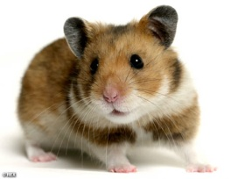
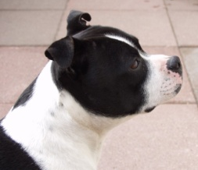
3 comforting thoughts & Calming down visual support
.

Slide 40
Problem Solving Skills - Adolescents
What is the problem? : _______________________________________
What are all the things I can do to handle it?
1.
2.
3.
What will happen if I do each of those things?
1.
2.
3.
Which way of handling it is the best?
Now that I have tried it, how did I do?
Can I do anything differently next time?

Slide 41
Exposure

Slide 42
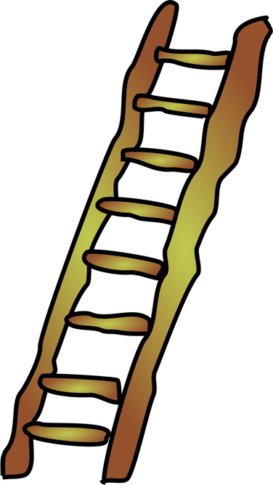
Exposure
Create an Exposure Ladder
Role play, rehearse, strategy, rewards. When achieved, start on the next rung of the ladder.
Once a specific behaviour has been managed with the use of a reward, continue to reward its successful completion for at least 2-3 weeks thereafter.

Slide 43
Graded exposure to little things first.
Start with a situation that causes the least anxiety
Then gradually increase exposure to situations that cause more anxiety.
Practice
Praise
Rewards

Slide 44
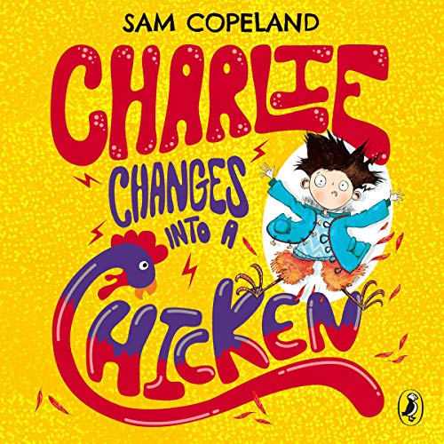
Children’s Books on Anxiety
https://e2epublishing.info/blog/10-best-books-anxiety
Ten fantastic books to help children understand, manage and overcome anxiety, worry and stress, providing lessons and coping strategies through story that will stay with them as they grow
Charlie Changes into a Chicken by Sam Copeland
All Birds Have Anxiety - Kathy Hoopmann;
Huge Bag of Worries – Virginia Ironside.
How Are You Peeling – Saxton Freymann (2004)

Slide 45
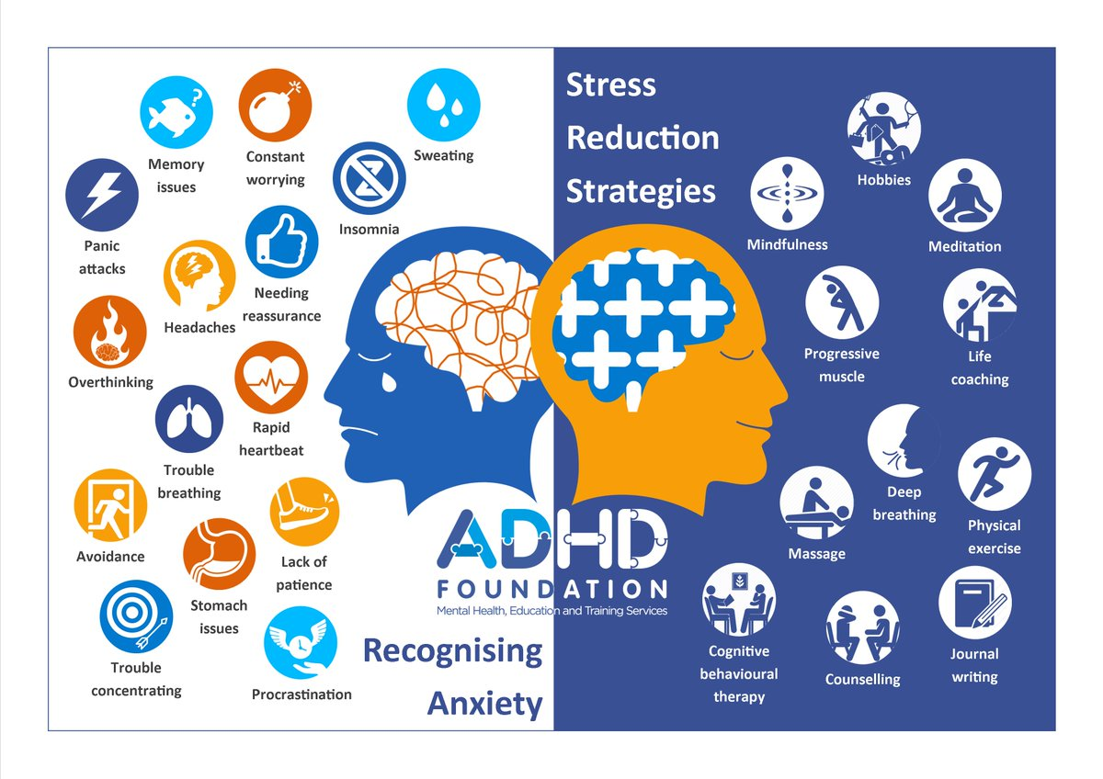

Slide 46
To summarise:
Anxiety is associated with ADHD – 40% CYP with ADHD;
Neurodevelopmental condition and consequences;
Some overlap between symptoms ADHD and anxiety, but each has distinct features;
Anxiety is communicated in a variety of ways;
Methods of managing anxiety.

